Slide 1
Current activity in GASKAP and its feedback to SKA-EA collaboration
Hiroshi Imai
Graduate School of Science and Engineering, Kagoshima University
International Center for Radio Astronomy Research/University of Western Australia

Slide 2
Astrometry with SKA: case of OH maser sources
Workshop on
East-Asian Collaboration for SKA
in Daejeon, Korea on 2011 December 2
Hiroshi Imai
Graduate School of Science and Engineering, Kagoshima Univ.
GASKAP collaboration
GASKAP=Galactic Australian SKP Pathfinder Spectral Line Survey

Slide 3
Why GASKAP? OH maser/SKA mid-band astrometry
Major maser lines in SKA mid-band
Targets of wide-field VLBI astrometry
Nearby HI 21-cm line
Wide variety of populations of OH maser sources
star forming regions (high-mass, intermediate mass YSOs) in the Galactic thin disk (1665, 1667 MHz)
evolved stars (long period variables, OH/infrared stars) in Galactic thick disk, bulge, halo (including globular clusters)
Unique property of 1612 MHz OH maser sources
Light curve phase-lag technique for distance determination
sites of present mass release from dying stars in the Milky Way
GASKAP: wide field survey towards the Galactic plane

Slide 4
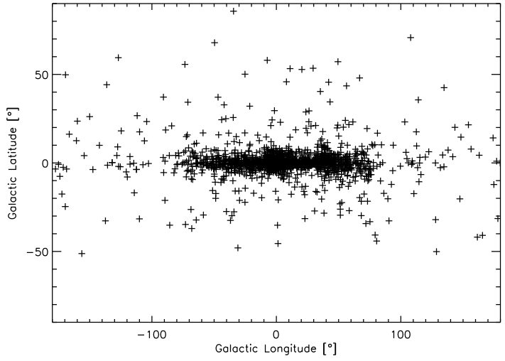
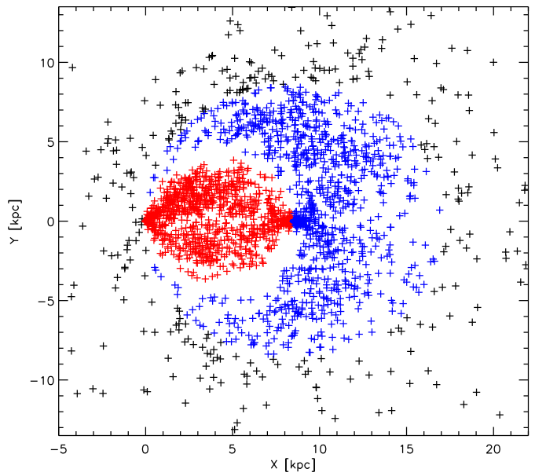
Stellar OH maser sources distributed in the whole Milky Way …. including optically obscured regions
Mira variables, OH/IR stars
post-AGB stars, supergiants
From targeted (VLA/Parkes/ATCA) to unbiased sky survey (GASKAP)
http://www.hs.uni-hamburg.de/~st2b102/maserdb

Slide 5
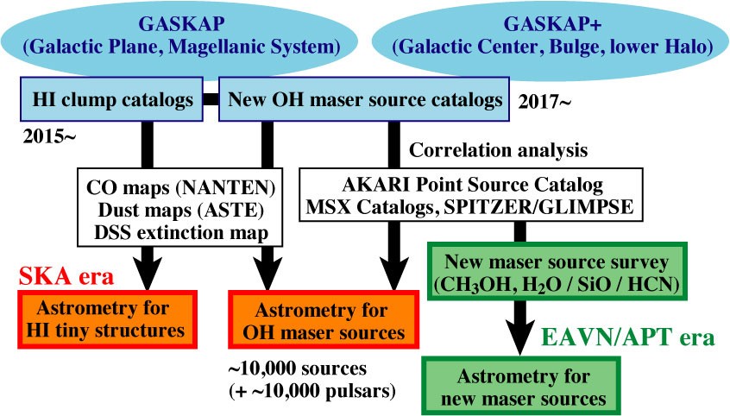
Possible GASKAP/SKA/EAVN collaboration in maser source astrometry

Slide 6
GASKAP’s current milestones: source finding
~10,000 OH maser source detections with GASKAP
1% false detection/identification causes 100 fakes.
Finding best sets of input parameters for source finding with highest completeness and reliability.
Real radio image contaminated by side lobes of synthesized beam pattern, causing artificial peaks.
For GASKAP
Real observations begin from 2013.
Most difficult cases towards the Galactic center.

Slide 7
GASKAP stellar OH maser simulations
Input maser sources:
1338 stellar OH maser components towards the Galactic center
Single/double components per source (1612-MHz OH maser)
Simulated image cubes
10” grid, 0.2 km/s velocity spacing
1,532 x 1,532 x 4,000 voxels, 38 Gbytes
Gaussian distribution noise with r.m.s. of ~6.5 mJy
Undeconvolved (dirty) and convolved (CLEANed) image cubes
Source finding tests
Duchamp source finder: C language software
theSkyNet computer array at ICRAR (now waiting/going)
~5,000 subsections of the original cube
~100,000 trials with different sets of source finding parameters
Selavy source finder: Java script software
Analyses of source finding results …. now in construction
Completeness and reliability
Distributions of false detections/identifications

Slide 8
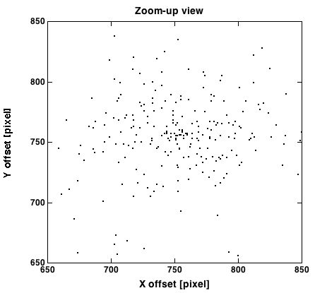
Input 1612-MHz OH maser sources
ASKAP FoV (~30 deg²) ASKAP beam (~30”)

Slide 9
First trials with a convolved image cube
reliability
completeness
Different true/false detection criteria
10 -- signal / noise ratio cutoff -- 4
How about cases with a dirty cube?

Slide 10
Feedback to SKA-EA collaboration
Current projects (VERA+KVN, etc.)
Source finding on H₂O / CH₃OH maser cubes
Source finding on HI / CO emission cubes
SKA astrometry / interstellar matter / SETI
Development / case study on source finding scheme
New faint target sources through GASKAP output

