Slide 1
Introduction to Earth Science Systems 4. A short tour of the solar system and beyond

Slide 2
Why study Planetary Sciences ?
l Studying processes on other planets helps us understand our own planet.
l Helps us understand the origin and evolution of the Solar System, hence our planet.
l Understand risk (asteroid impacts etc …)
l Find possible valuable resources (Earth’s resources are not infinite !!) & colonnisation of other worlds (not enough room on Earth !!).
l It’s interesting! Natural curiosity, popular interest ...
l Possibility of life elsewhere, and the origin of life on Earth.

Slide 3
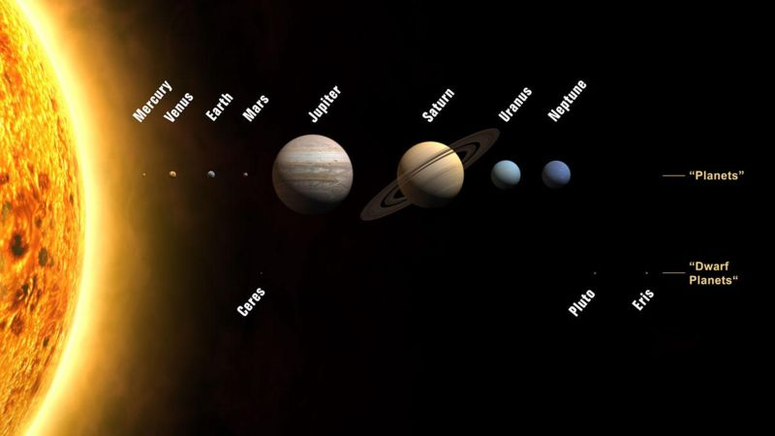
The solar system

Slide 4
Basic Solar System observations
l Stars are fixed with respect to each other but appear to rotate through the sky on a daily basis, with seasonal changes.
l Sun & Moon move through the sky on a restricted path called the Zodiac (ecliptic for the Sun).
l Planets (wanderers) move relatively to stars through Zodiac.
l Sometimes planets move backwards (retrograde motion).
l Venus and Mercury always stay close to horizon (visible just after sunset or before sunrise), i.e., their angular distance from the Sun is never larger than a given value (maximum elongation).
l Apparition from comets from time to time, some of them being periodic (Halley, Encke, Tuttle, …).

Slide 5
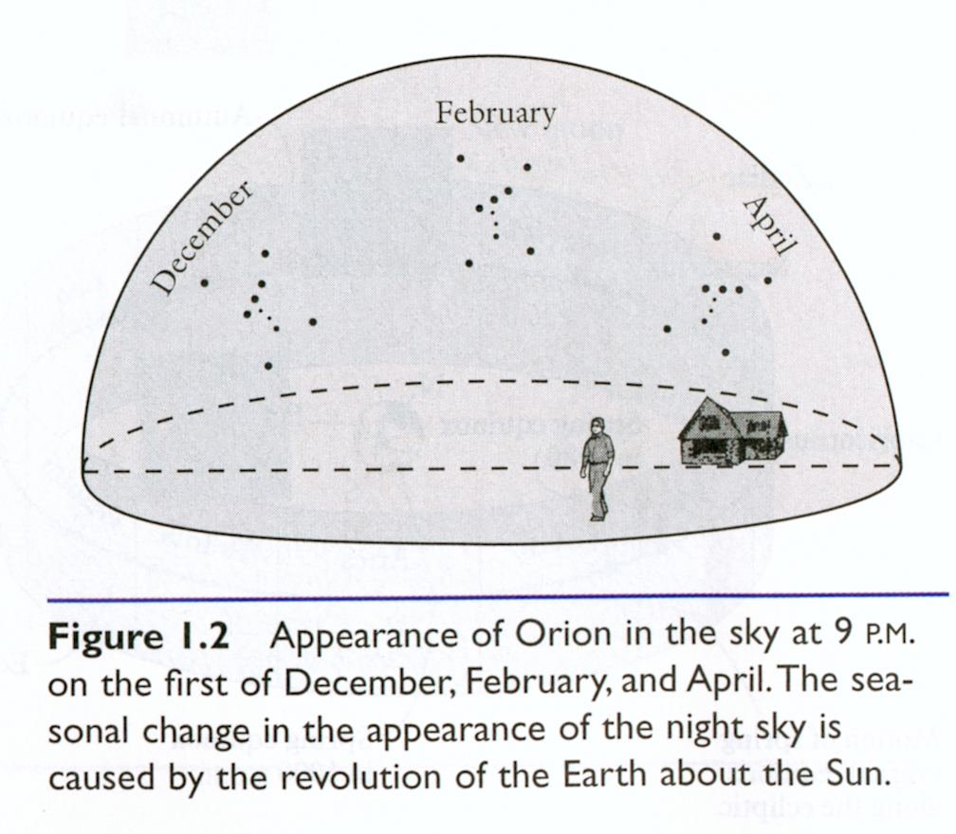
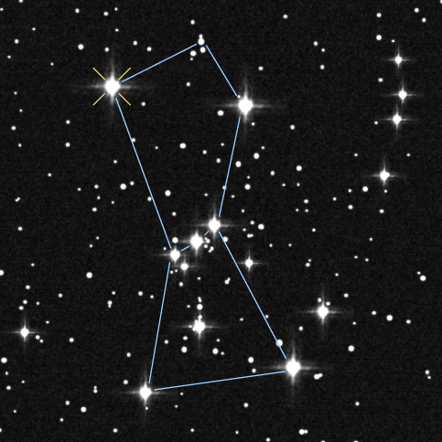
Seasonal variation of constellations appearance
At a given latitude, the constellations visible and their position in the sky vary on a yearly basis

Slide 6
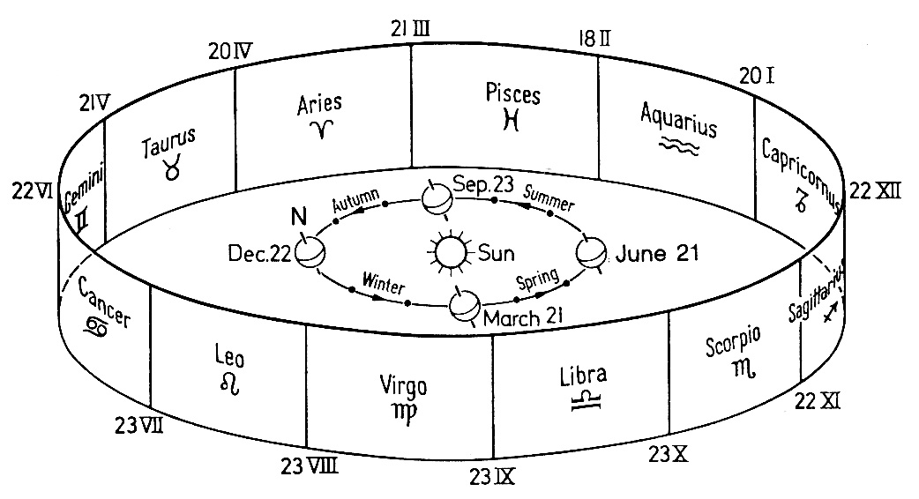
Yearly planetary motion along the zodiac
Sun, Moon, & planets move along fixed line through stars, within a narrow band: the zodiac.

Slide 7
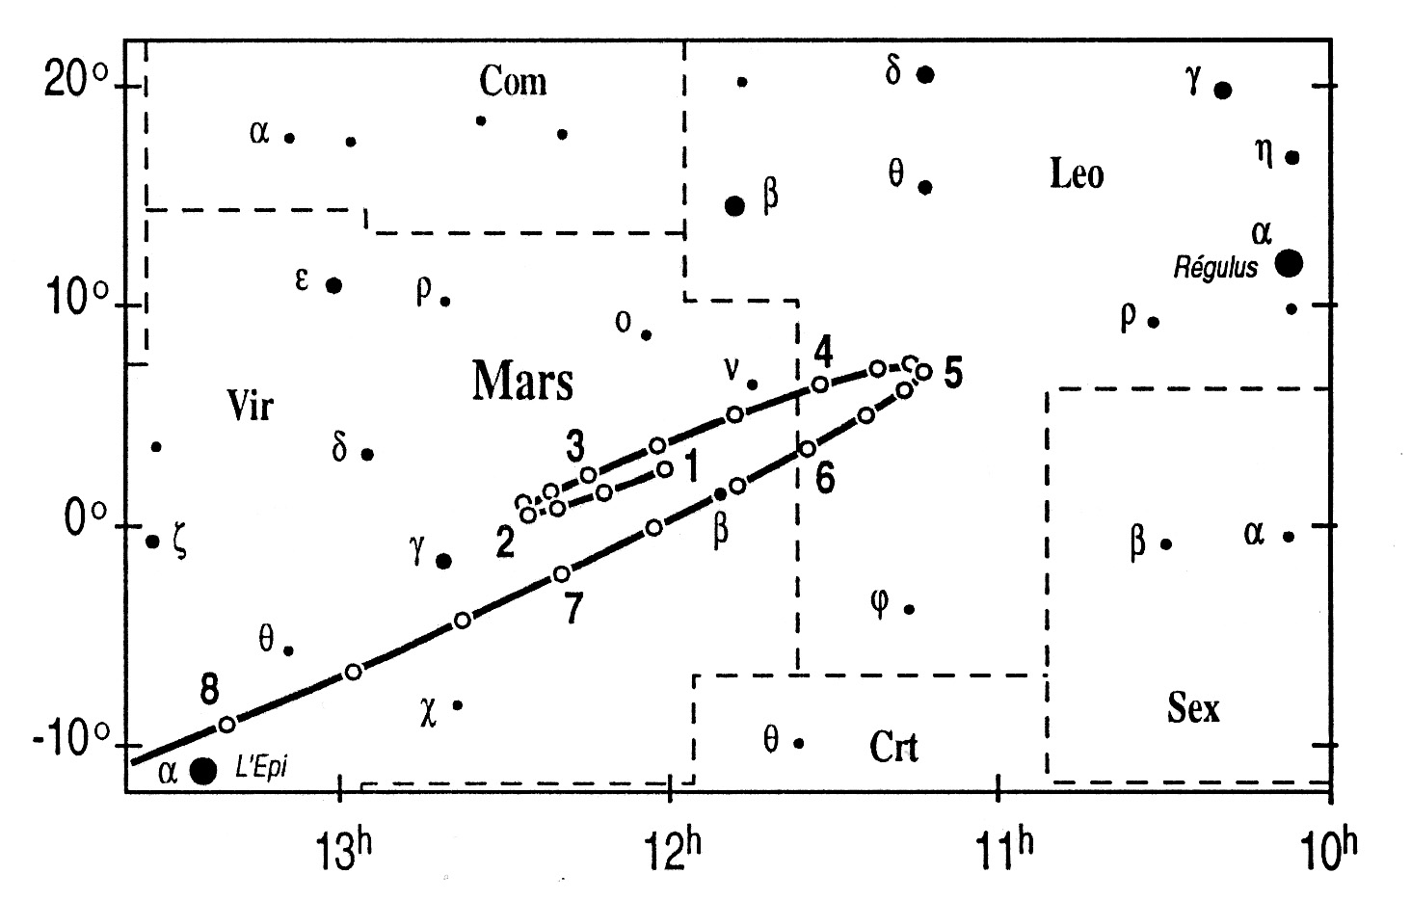
Planetary retrograde motions
l Mars, Jupiter, and Saturn experience retrograde motions in the sky.

Slide 8
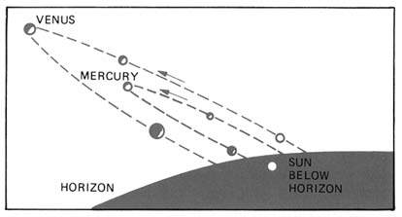
Mercury and Venus: maximum elongation
l Mercury and Venus experience retrograde motions and their angular distance to the Sun is never larger than a maximum value, or maximum elongation .

Slide 9
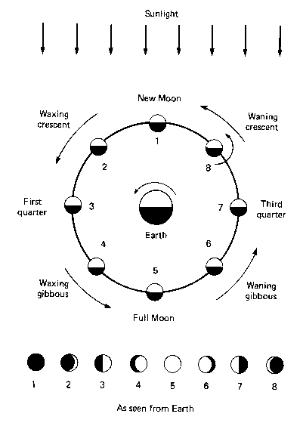
Phases of the Moon

Slide 10
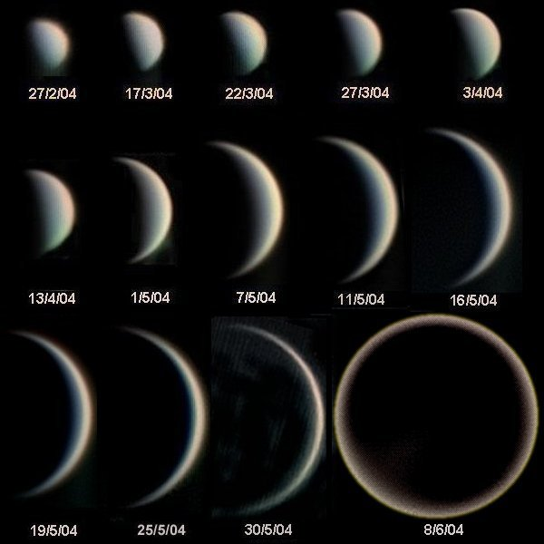
The phases of Venus
Venus also has phases

Slide 11
Solar System models
l Geocentric (Earth at center).
- Anaximander (610- 546 BC): concentric shells
- Ptolemy (100 AD): Orbits are perfect circles + epicycles to explain the retrograde motions.
l Heliocentric (Sun at center).
- Copernicus (1473-1543). Circular orbits explains retrogrades but still needed epicycles.
- Tycho Brahe (1546-1601). Accurate observations of the position & motion of planets.
- Johannes Kepler (~1610). Elliptical orbits. Kepler’s Laws.
- Galileo Galilei (~1610). Built & used a telescope: observed the Phases of Venus, moons around Jupiter, and craters on Moon.

Slide 12
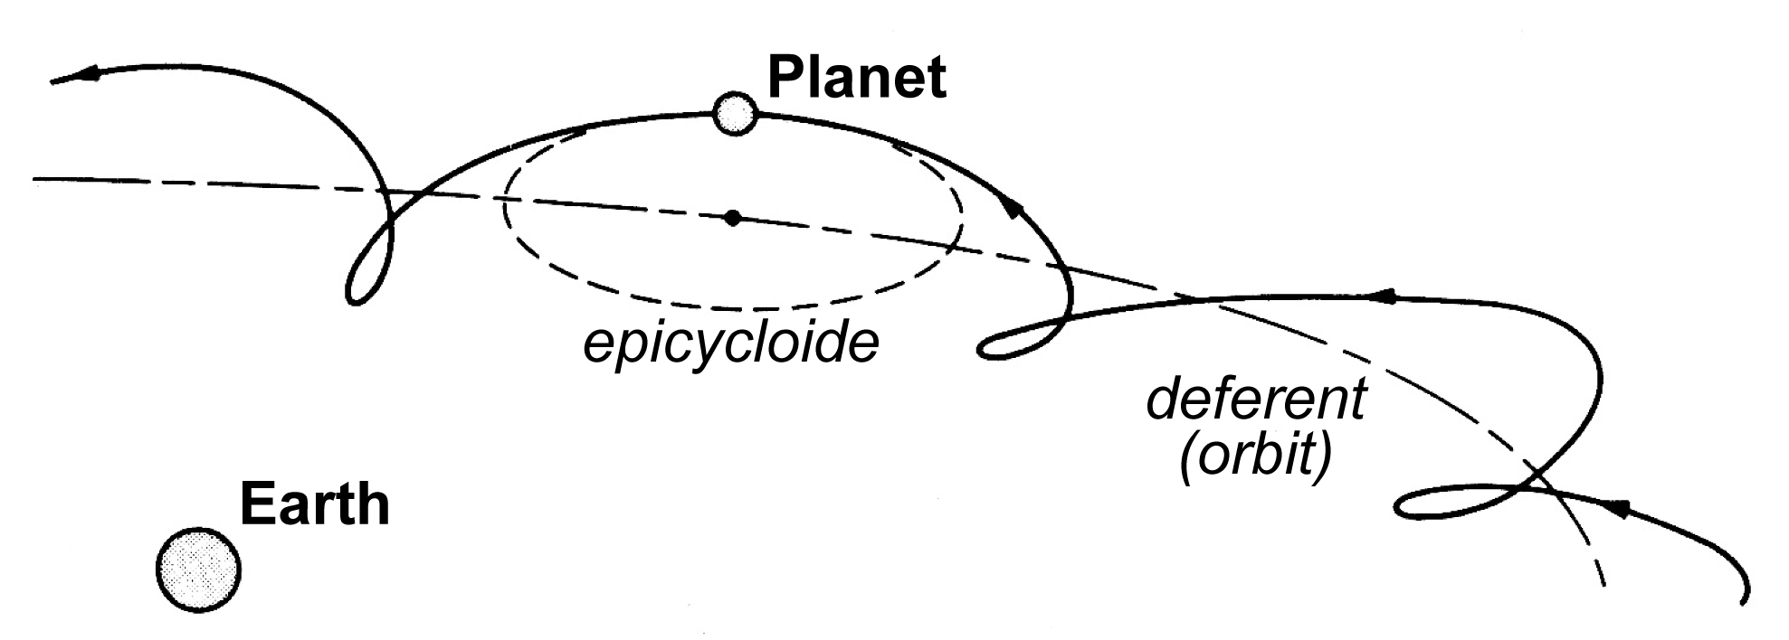
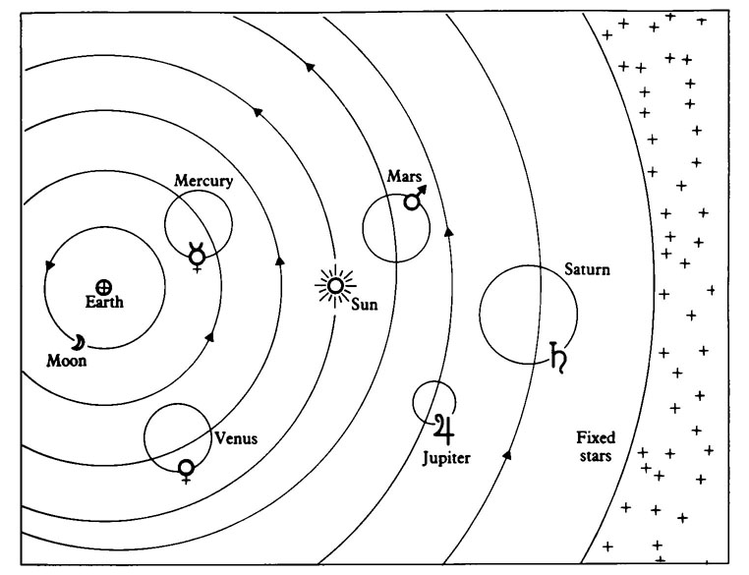
Ptolemy’s model: geocentric + epicycles

Slide 13
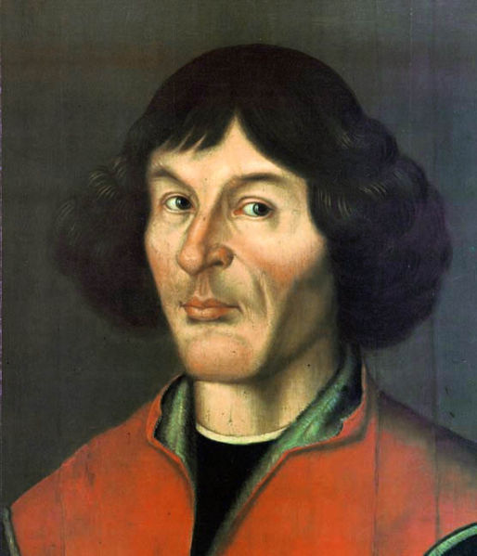
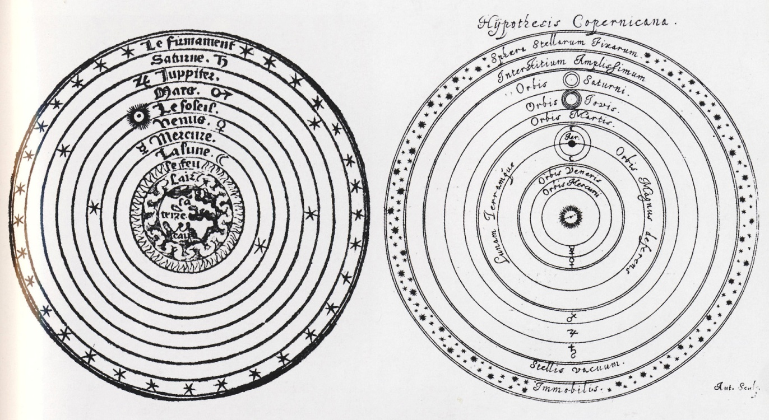
Nicolaus Copernicus (1473-1543)
Heliocentric model (De Revolutionibus Orbis Caelum)

Slide 14
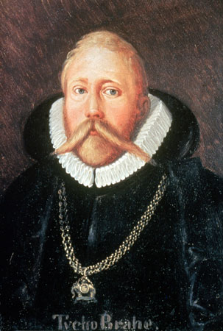
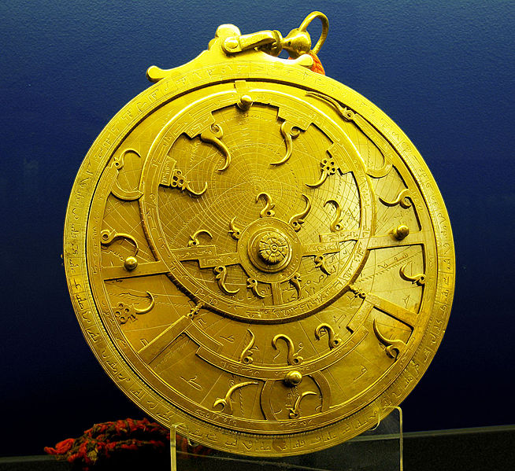
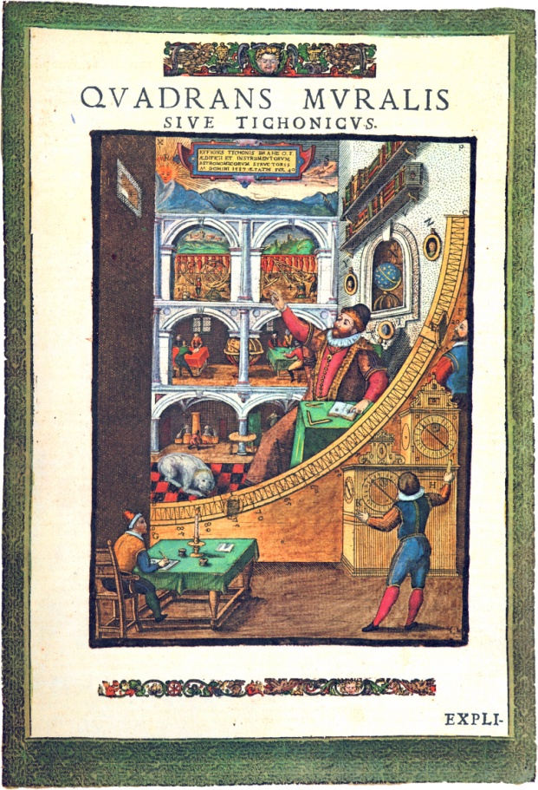
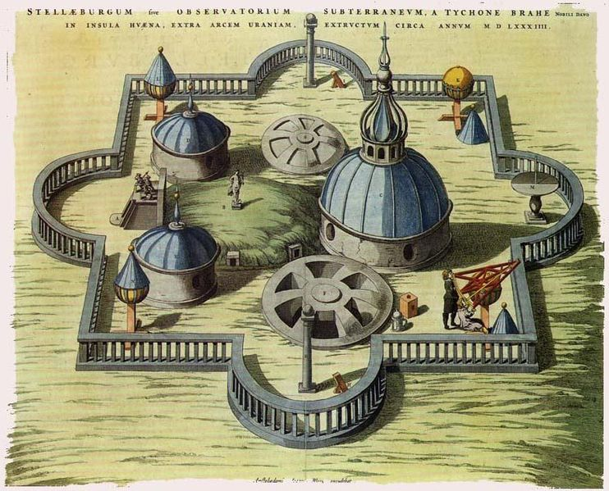
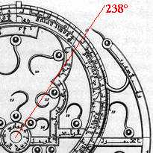
Tycho Brahe (1546-1601)
l Built large instruments dedicated to observations of the movements of planets.
l Uses astrolabes (… but no optical instruments; telescope will be invented a few decades latter) to carefully measure the position and motions of planets …
l … but did not try to interpret his data.

Slide 15
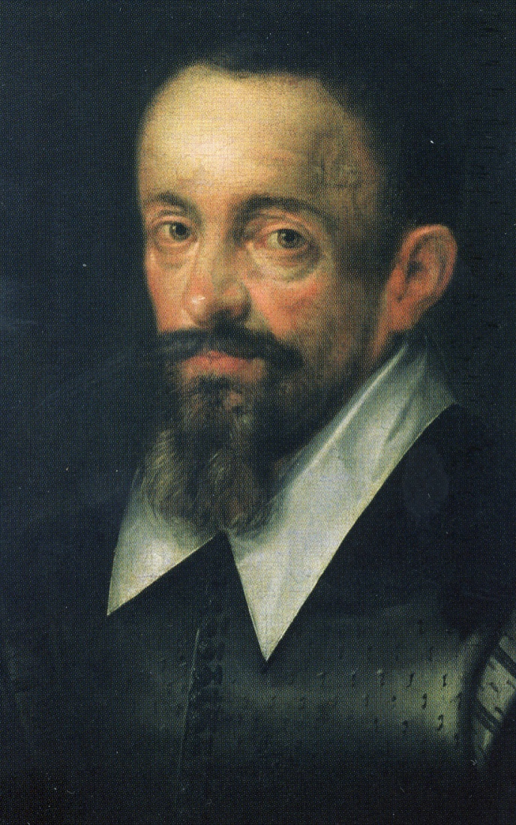
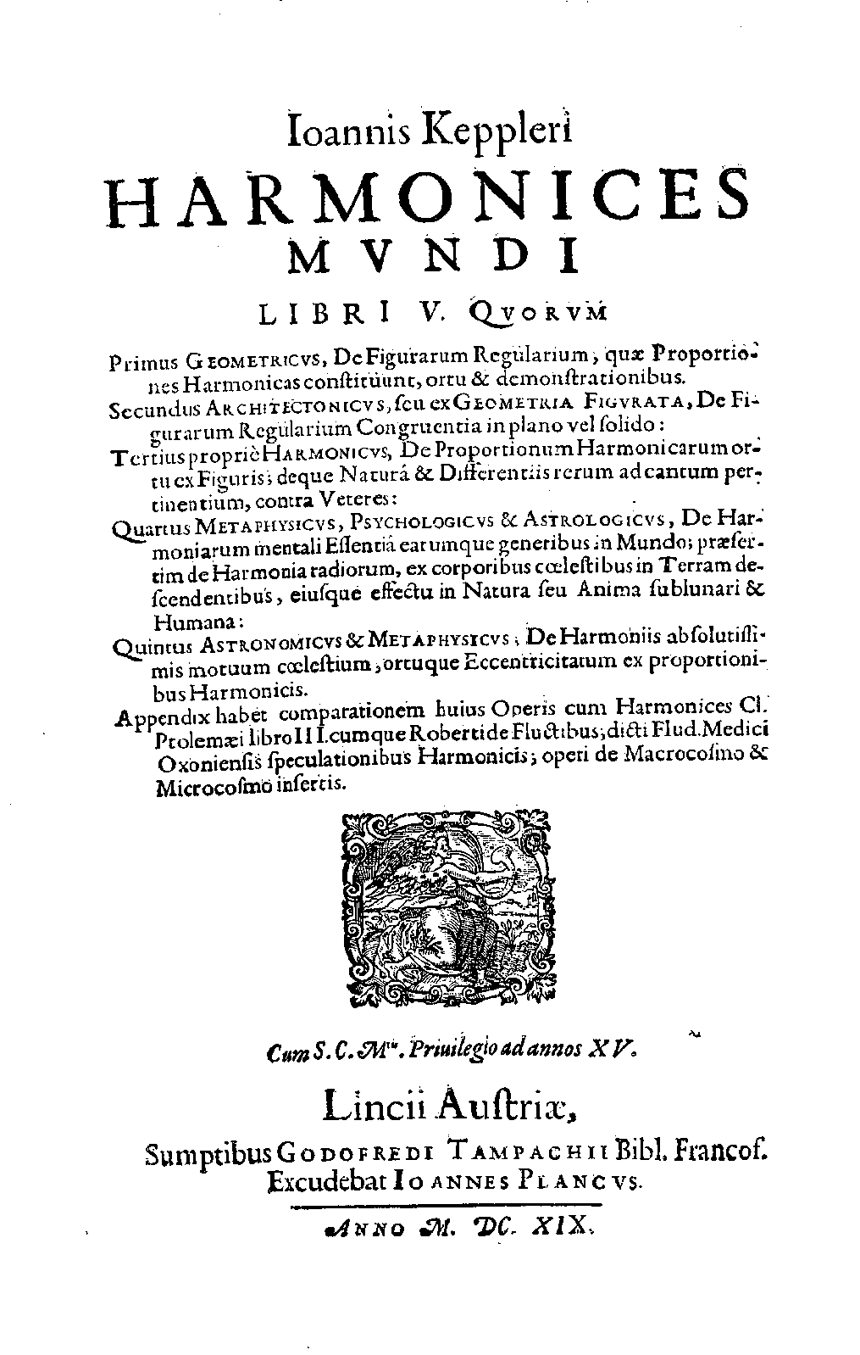
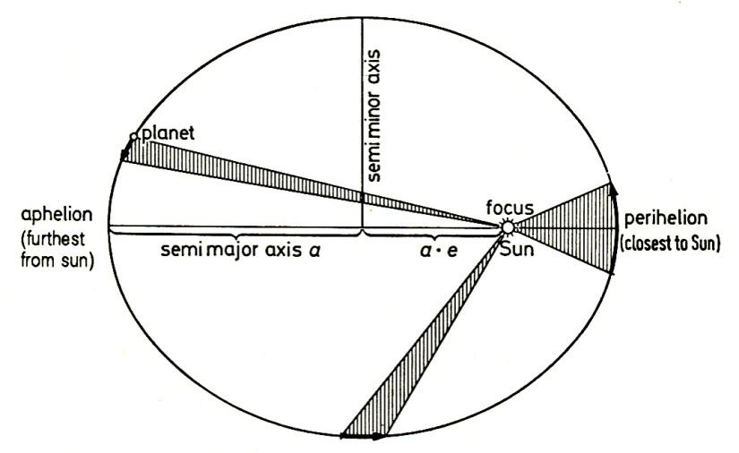
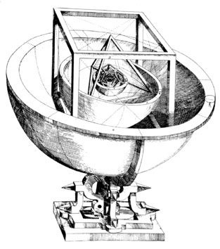
Johannes Kepler (1571-1630)
Found a mathematical fit to Brahe’s observations: Kepler's laws (1609-1619), published in Harmonices Mundi :
- Orbits are ellipses, not perfect circles!
- … but keep the polyhedrons model to explain orbit radius

Slide 16
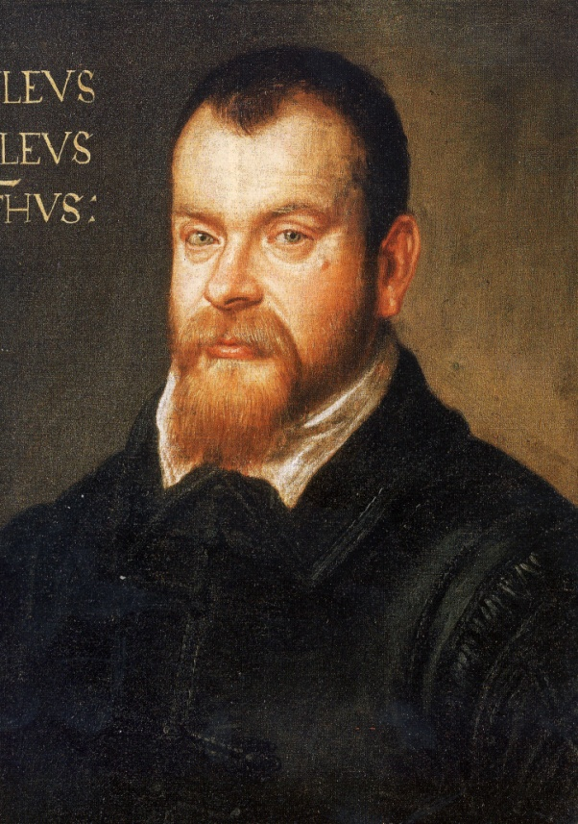
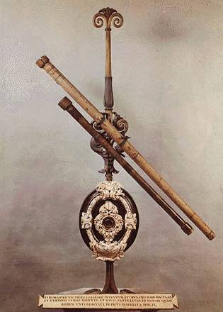
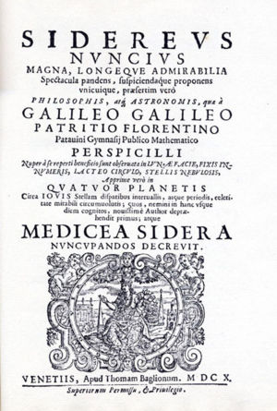
Galileo Galilei (1564-1644)
l First to use telescope and point it to the sky
l Made observations supporting heliocentric model:
- Moons around Jupiter
- Phases of Venus
- Imperfect Moon (cratered surface)

Slide 17
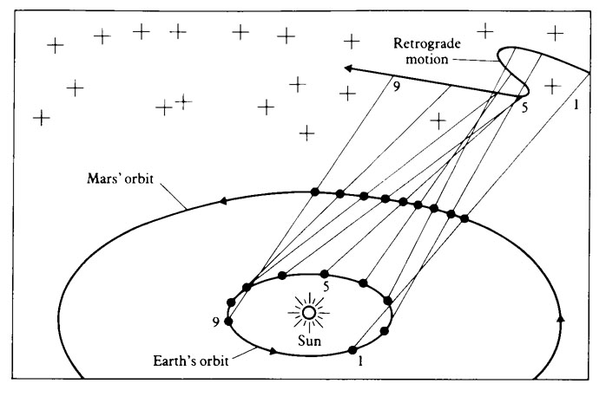
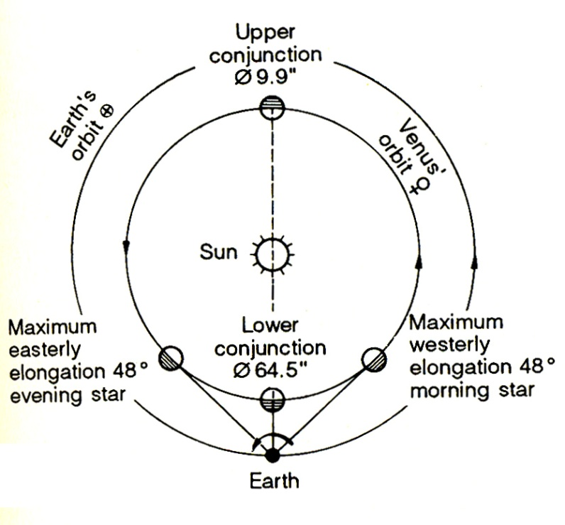
Heliocentric model explains …
… retrograde motions without epicycles …
… and the maximal elongations of Mercury & Venus.

Slide 18
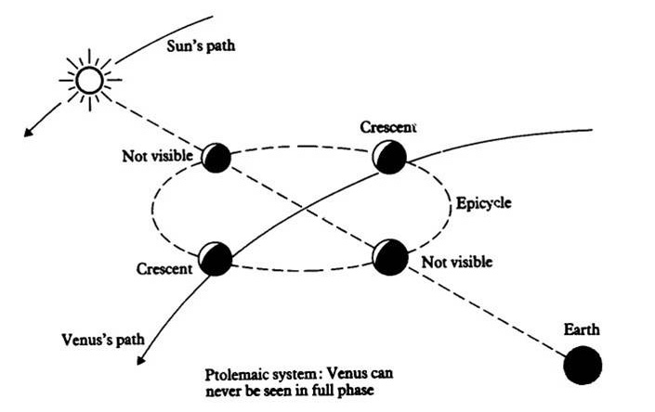
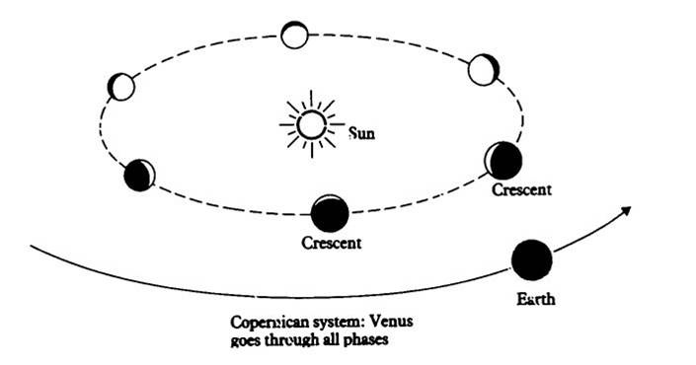
The phases of Venus: geo- vs helio-centric systems
The Ptolemaic system fails to explain the phases of Venus …
… but the Copernician model does explain

Slide 19
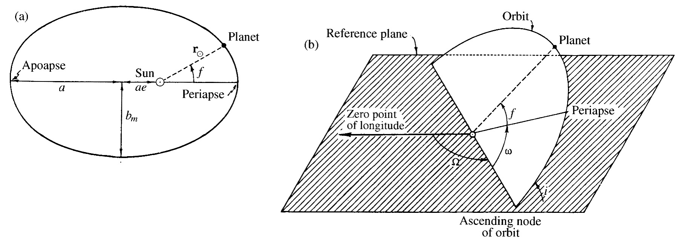
Orbital parameters
The location of a planet on its orbit is fully described by 6 parameters:
- Semi-major axis, a.
- Eccentricity, e.
- Inclination, i : angle between the orbital plane and the reference plane (ecliptic).
- Longitude of the ascending node, Ω : angle between a reference direction in the ecliptic, and the direction of the ascending node.
- Argument of the perihelion, ω : angle between the direction of the ascending node and that of the perihelion.
- True anomaly, f : angle between the position of the planet and the perihelion.

Slide 20
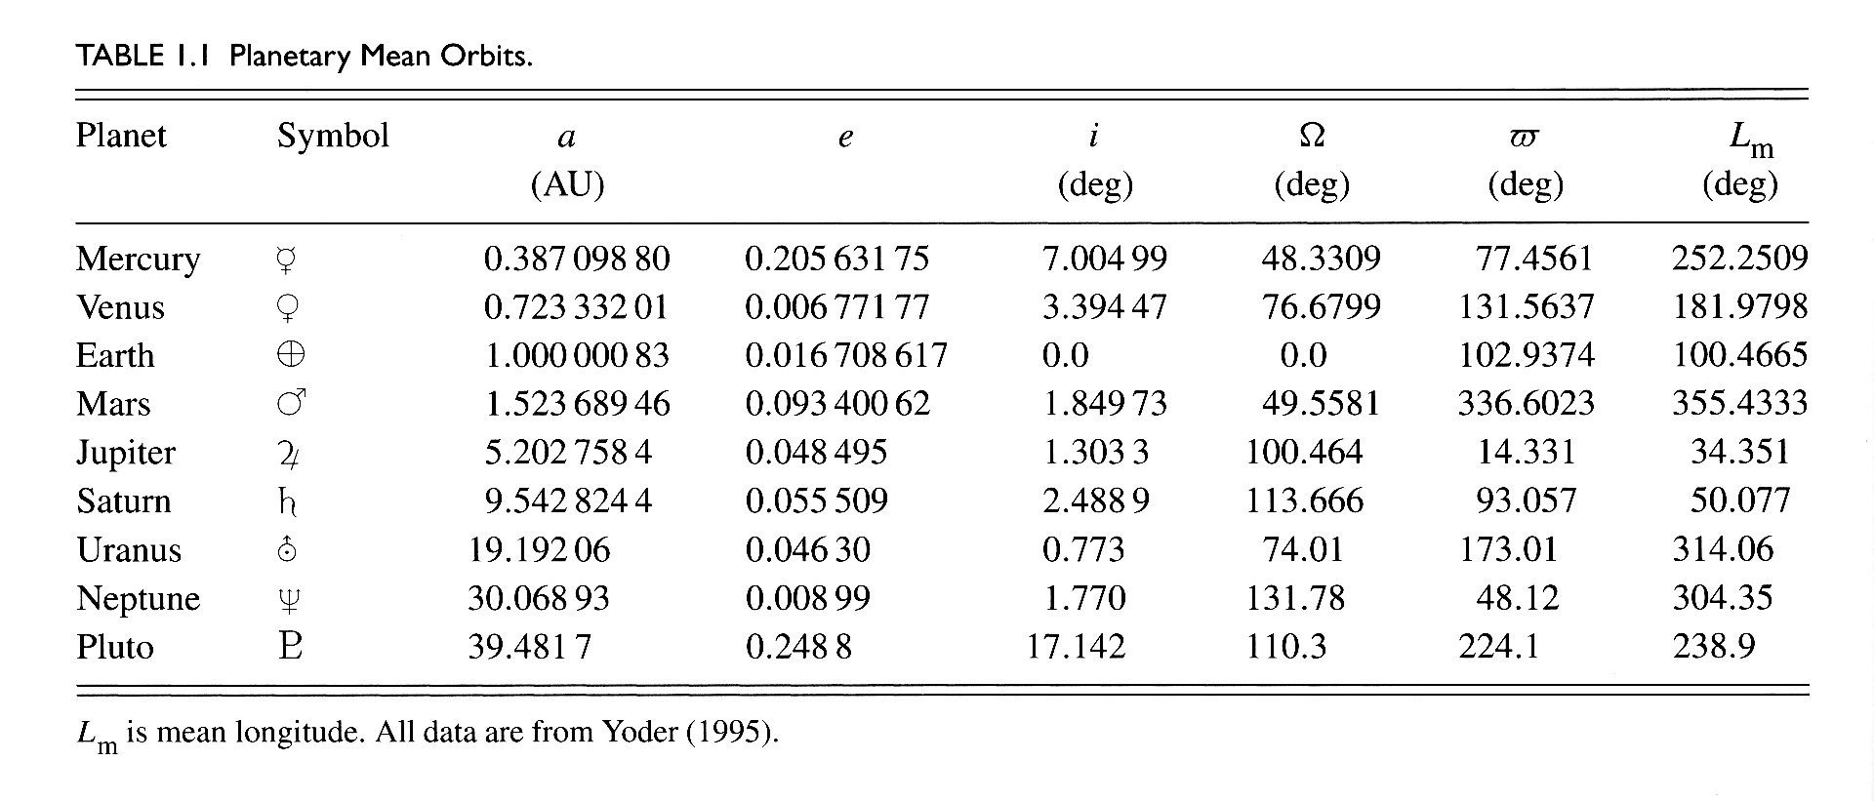
Orbital parameters of planets

Slide 21
Planetary Orbits: inclinaisons
l Most planets orbit close to the ecliptic plane, and counter-clockwise …
l … except Mercury and Pluto, which have inclinations of 7° and 17°, respectively.

Slide 22
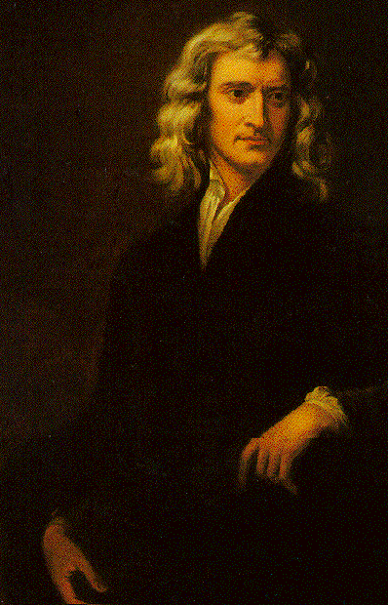
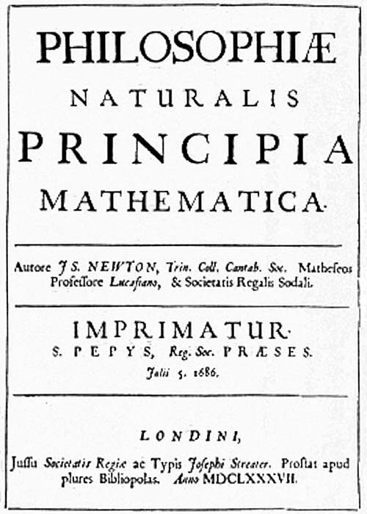
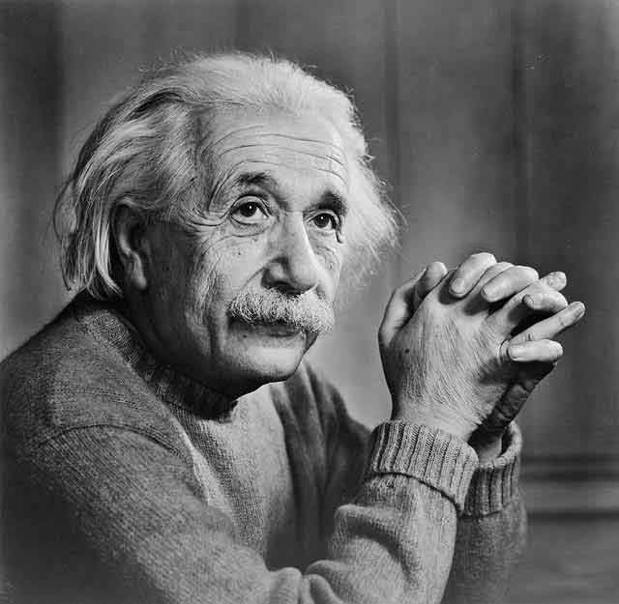
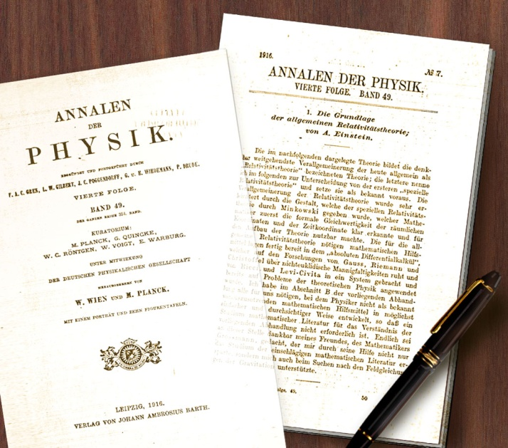
Fundamental Physics of Planetary Motions
l Kepler’s Laws say HOW planets move, not WHY
l Isaac Newton (1687). 3 Laws of motion, and law of gravity (Principia Mathematicae, 1687). Explain Kepler’s laws from fundamental principals. But some things not explained (e.g., precession of Mercury’s orbit).
l Albert Einstein (1879-1955). Theory of General Relativity (1906). Distorting space-time continuum. Explains precession of Mercury’ orbit.

Slide 23
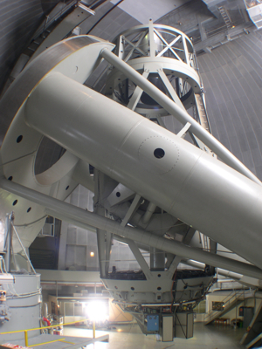
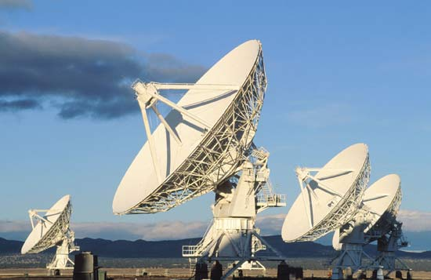
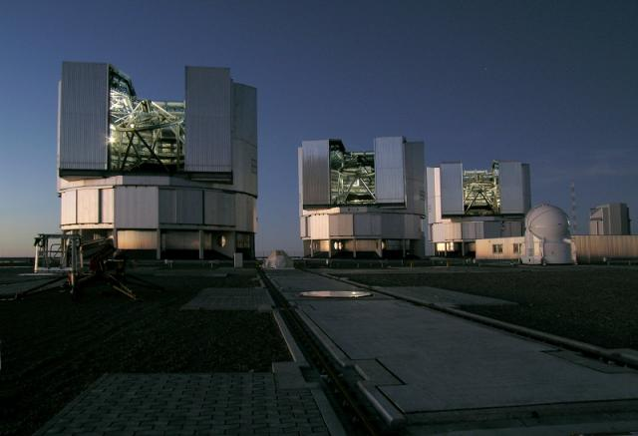
The modern era: telescope observations
l Look at many different wavelengths (radio, IR, visible, UV)
l Better resolution and precision (larger mirrors, interferometry)
l Observe surfaces, atmospheres, orbits, shapes, rotation, reflected radiation, emitted radiation, ...
l Information about composition (surface & atmosphere), mass, internal mass distribution, temperature, ...

Slide 24
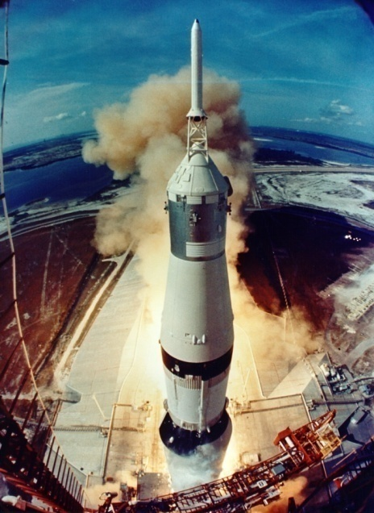
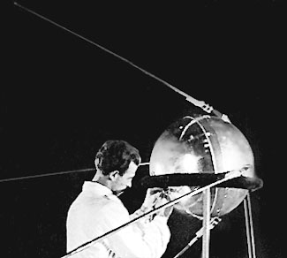
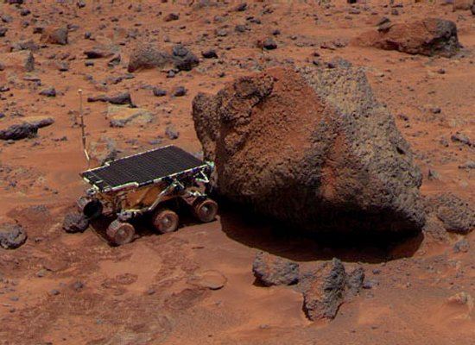
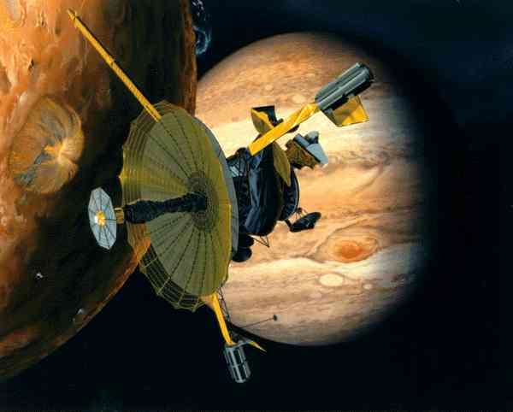
The modern era: spacecraft exploration
l Started in 1959 (Luna 1 to moon- USSR)
l Been to every planet
l Humans have been to Moon (Apollo, USA)
l Observation & study of the Earth
l Spacecraft also landed on Venus (Venera; USSR), Mars (Viking, Pathfinder, Rovers), and comets (Tchuri)
l Probes dropped into Jupiter (Galileo), Titan (moon of Saturn) (Cassini-Huygens 2005)

Slide 25
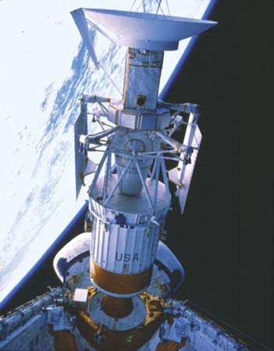
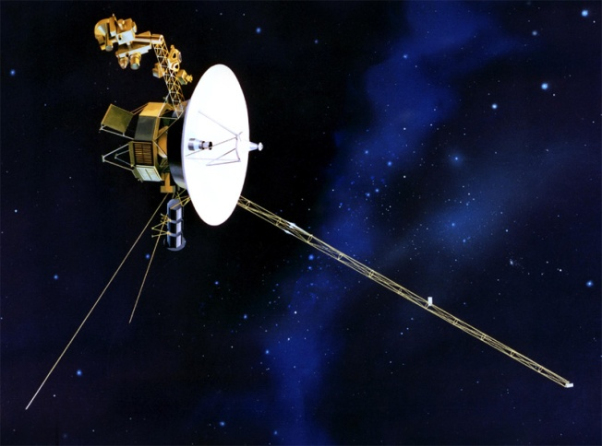
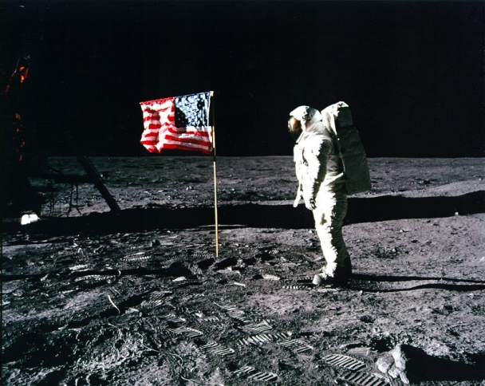
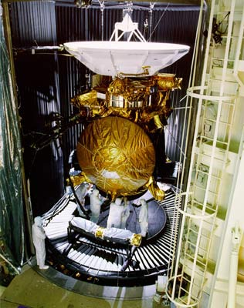
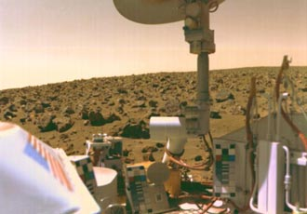
Some important dates of space exploration
l Apollo 11-17 (Manned exploration of the Moon) 1969-1972
l Viking 1 & 2 (First landing on Mars) 1976
l Voyager 1 & 2 (Jupiter, Saturn, Uranus, Neptune) 1970s-1990
l Magellan (Venus) early 1989-1994
l Galileo (Jupiter system) late 1989-2003
l Mars Global Surveyor late 1996-2006

Slide 26
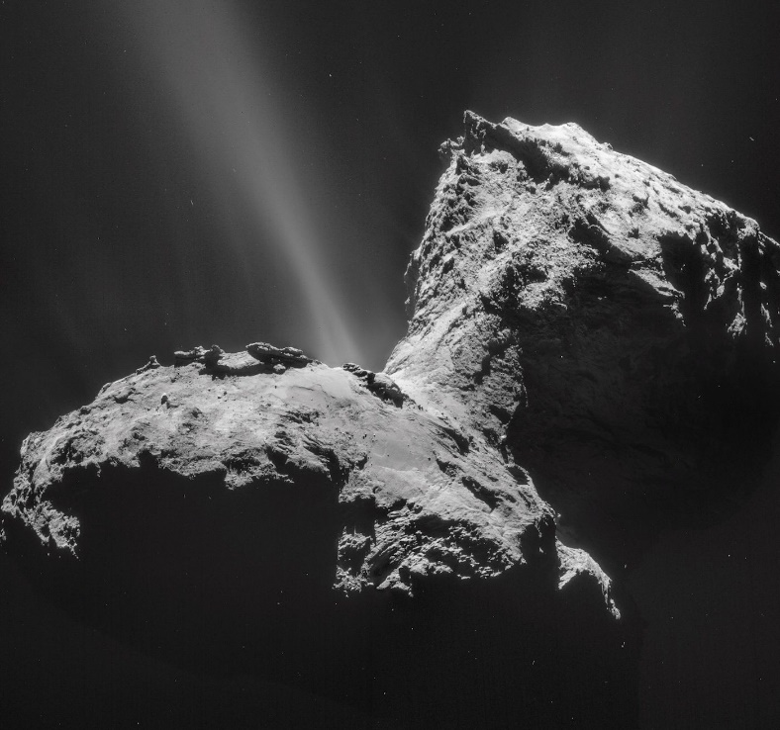
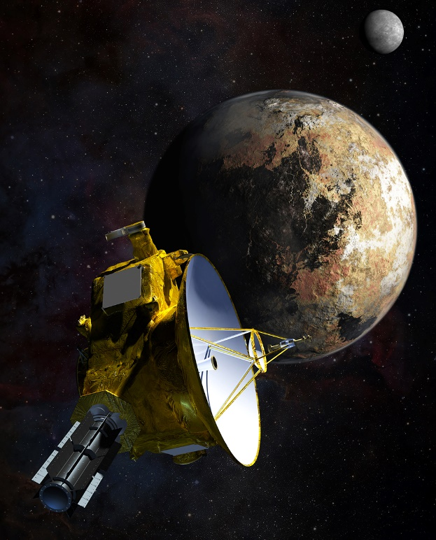
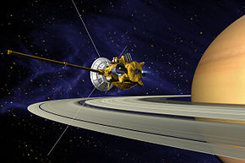
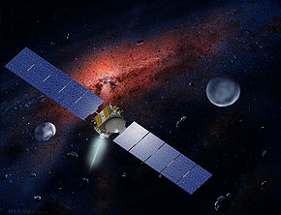
Some important dates of space exploration
l Mars Odyssey (Mars) 2001-Now
l Mars Exploration Rovers (Mars) 2003-Now
l Cassini/Huygens (Saturn system) 1990-Now
l Messenger (Mercury) 2011-Now
l Dawn (Asteroid belt- Vesta, Ceres) 2010-Now
l Rosetta (comet 67P Churyumov-Gerasimenko) Now
l New-Horizon (Pluto, Kuiper belt) Flyby Pluto in July 2015
l More to come : InSight, Juno, Bepi Colombo …

Slide 27
(preliminary) inventory
- The Sun, plus the heliosphere, region filled with solar wind (plasma of electron and proton) and the solar magnetic field.
- 4 Giant planets (2 giant gaseous, 2 giant icy).
- 4 rocky planets.
- Satellites of planets, with a large range of size and composition.
- Asteroids, Small bodies with (radius < 500 km), mainly between Mars and Jupiter Mars.
- Comets, originating from the Oort cloud (~10000-50000 AU) and the Kuiper belt (~30-50 AU).
- Kuiper belt objects and dwarf planets (e.g., Pluto).
- Meteorites.

Slide 28
The new Solar System
l Pluto is not a planet anymore, but a dwarf planet.
Other dwarf planets (so far): Ceres, Eris, Makemake, Haumea. Many other candidates, mainly from Kuiper belt.
l Inner solar system: rocky planets and asteroid belt.
l Outer solar system: giant planets and Kuiper belt.
l Kuiper belt objects (or Trans Neptunian Objects): small bodies, and dwarf planets (Pluto, Eris, Haumea, Makemake)
Include main belts + scattered disk objects, with much more eccentric orbits, extending over 100 A.U.
l Oort cloud (not observed, hypothetical reservoir of comets).

Slide 29
Largest (known) KBO

Slide 30
KBO’s distribution and orbits
l Large inclination and eccentricities, especially scattered disk object.
l Scattered disk objects: semi-major axis arger than 50 A.U., but eccentricities implies that their perihelion is within the Kuiper belt.

Slide 31
Distances in the Solar system
The Earth-Sun radius is taken as reference : d_{SE} = 1 AU ~ 150×10⁶ km
l Inner solar system (Mercury-Mars) : 0.4 – 1.5 A.U.
l Asteroid belt: 1.7 – 4.5 A.U.
l Giant planets: 5.2 – 30 A.U.
l Kuiper belt (main belt): 30-50 A.U. + scattered objects (e.g., Eris) with orbits extending well beyond 100 A.U.
l Heliopause (boundary between the heliosphere and the interstellar medium): about 200 A.U..
Voyager 1 just crossed the heliopause in 2010!
l Oort cloud (reservoir of comets): 10⁴ to 5.0×10⁴ A.U..

Slide 32
More planets ?
l Scattered disk objects: large eccentricities and semi-major axis, but perihelion within the Kuiper belt. Orbits may result from perturbations of Neptune.
l Detached objects: perihelion further away than Kuiper belt’s outer edge, and very large eccentricities: e.g., Sedna a = 542 A.U., e = 0.859, perihelion = 76 A.U.
l Orbits of detached objects cannot be due to perturbations from Neptune. These objects may be Oort cloud objects sent on inward orbits by gravitational perturbations due a hypothetic, far away giant planet

Slide 33
Planet 9
l More hints for a 9th planet : direction (argument) of perihelion and longitude of ascending node of detached objects are all within a narrow range of values.
l This maybe related to gravitational perturbations due to the presence of a giant planet in opposite direction.
l Possible properties : - eccentricity : 0.5-0.8;
- semi-major axis 500-1500 A.U.;
- mass : 5-15 Earth masses.

Slide 34
Composition & density
l What are the compositions of these planets and moons, and how to determine them?
Composition can be deduced from
- Density, combined with …
- Cosmic abundances of the elements, and
- Composition of the surface (e.g., from spectra)
l How can we measure density of planets and moons?
Density = Mass/Volume
- Volume: calculated from diameter, easily observed/measured.
- Mass: need to observe gravitational influence on surrounding objects, e.g., orbital period of moon => mass of planet (Kepler’s 3rd law). Or if no moon, gravitational influence on other objects.

Slide 35
Large planets: self-compression
l The pressure inside a planet can compress materials in this interior.
l This can significantly increase the density of minerals within the planet, and the density of the planet as a whole.

Slide 36
Planets sizes & densities

Slide 37
What materials are available to make a planet?
Abundances of different elements in the solar system is mostly H and He (+ other, less abundant elements; see Sun lecture), but needs modification:
1. Elements join together to make compounds (water, carbon dioxide, quartz, calcite, …)
2. Solid planets are made of substances that were solid at the (HOT) temperature that they formed … so gases and ‘volatiles’ are missing, and ‘icy’ substances only found in outer solar system.

Slide 38
Cosmic abundances of elements

Slide 39
Four planet-forming types of matter
l Gas: mostly H and He
l Ice (‘volatiles’): e.g., H₂O, CO₂, CO, NH₃, CH₄. Solid at low temperature, density ~1 g/cm³
l Rock: silicates (silicon oxides with Mg, Fe, Al). Density ~3 g/cm³
l Metal: mostly Fe, with some Ni. Density ~ 8 g/cm³

Slide 40
H and O; ‘reducing’ vs. ‘oxidizing’
l H and O two of most abundant and reactive elements, e.g., CH₄, CO₂, H₂O, NH₃, O₂.
l If O is more abundant : ‘oxidizing’ environment, lots of O compounds (oxydes) form. Inner planets tend to be oxidized.
l If H is more abundant : ‘reducing’ environment, lots of H compounds form. Outer planets tend to be reduced.

Slide 41
Snowline (or frost line)
l In proto-solar nebula, the temperature decreases with increases distance from the Sun.
l Snow line: distance from the star at which water can condensate. For the Sun, about 3.0-4.0 A.U. (some estimates up to 5.0 A.U.).
l Volatiles (CH₄, NH₃, N₂, CO₂) condensate at larger distances.
l Metal and rocks condensate at shorter distances.

Slide 42
Terrestrial planets: densities & formation
l Densities
Planet | Density | Uncompressed density
 | (g/cm³) | (g/cm³)
Mercury | 5.43 | 5.3
Venus | 5.24 | 4.0
Earth | 5.515 | 4.1
Moon | 3.36 | 3.3
Mars | 3.94 | 3.7
l Formed hot: primitive rocks differentiated into rock + metal
l Basically metal core + rocky mantle & crust
l Fraction of metal (i.e. size of core) decreases getting further from the Sun
l Moon much less metal than Earth even though same distance from Sun!
l Venus and Earth seem similar but surfaces quite different!

Slide 43
Where does the Earth’swater come from ?
l Earth formed too close from the Sun to be able to condense water.
l Water was brought by other objects :
- Comets, during the heavy bombardment phase.
- Planetesimals migrating from other regions and accreting to the proto-Earth
l Hints from D/H ratio in comets :
- D/H twice that in oceans.
- But recent measurements in comet 103P Hartley indicate D/H similar to that in oceans.

Slide 44
Jupiter & Saturn
l Radius, mass, & density:
Planet | Radius | Mass | Density
 | (km) | (10²⁴ kg) | (g/cm³)
Jupiter | 66854 | 1898.6 | 1.326
Saturn | 54364 | 568.5 | 0.687
l Composition:
- Mostly gas (H and He), similar to Sun
- Must have dense ‘cores’, probably rock and ice

Slide 45
Uranus & Neptune
l Radius, mass, & density:
Planet | Radius | Mass | Density
 | (km) | (10²⁴ kg) | (g/cm³)
Uranus | 25559 | 86.8 | 1.318
Neptune | 24973 | 102.4 | 1.638
l Composition:
- Much less compressed than Jupiter & Saturn
- Must have more heavy stuff (ice & rock)

Slide 46
Major outer solar system moons
l Densities between 1.5 and 3.5 g/cm³, indicating composition between ice + rocks and rocks.
Satellite | Radius | Mass | Density | Composition
 | (km) | (10²³ kg) | (g/cm³)
Jupiter
Io | 1821 | 893 | 3.53 | Transition from rock
Europa | 1565 | 480 | 3.02 | to ice + rock
Ganymede | 2634 | 1482 | 1.94 | as getting further
Callisto | 2403 | 1076 | 1.85 | from Jupiter
Saturn
Titan | 2575 | 1346 | 1.88 | Ice + rock
Uranus
Titania | 789 | 35 | 1.71 | Ice + rock
Neptune
Triton | 1353 | 215 | 2.05 | Ice + rock
l Pluto & Charo: not moons, but composition similar to ice + rock (density are 1.9 and 1.5 g/cm³, respectively).

Slide 47
Sun vs Planets
The Sun …
- … is 4.0×10⁸ times more luminous than Jupiter.
- … represents 99.9% of the total mass of the Solar System !

Slide 48
The Sun
l Dimensions: Mass 2.0×10³⁰ kg; Radius : 7.0×10⁵ km.
l Composition: mainly hydrogen and helium.
l Powered by fusion of Hydrogen into Helium following proton-proton cycle. Requires high-temperatures (1.5×10⁷ K) and high-pressures (2.5×10¹⁶ Pa) to overcome Coulomb repulsive forces.
l Heat transferred by radiation, and convection in the outer 20%

Slide 49
Mercury:
- a = 0.39 A.U.
- M = 0.055 M_{Earth}
- R = 2440 km
- Density: 5340 kg/m³

Slide 50
Mercury’s similarities to Moon
l Size (i.e. much smaller than Earth)
l Heavily cratered
l Highlands similar to lunar highlands
l Crater density indicates similar age
l Also has smooth lowland regions
l Negligible atmosphere
l Large variation in surface temperature
But:
l Mercury as a big core, the Moon a small one.
l Mercury has a permanent magnetic field (although small), the Moon none (but had one in the past)

Slide 51
Mercury’s core
l Large core : about 1800 km, i.e., 75% of Mercury’s size
l Partially molten (magnetic field).
l Possible layer or sulfur iron (FeS) between the outer liquid core and the mantle.

Slide 52
Measuring Mercury’s outer core
l Libration: small perturbation in the direction of the axis of rotation. Due to external gravitational coupling. Period and amplitude depends on internal structure
l Mercury’s libration is due to gravitational torque exerted by the Sun.
Main period: 88 days. Amplitude indicate decoupling between mantle and core, thus the presence of a liquid layer (only the mantle is affected by libration).
l Detailed study of other Mercury’s libration put a constraint on the size of the outer core.

Slide 53
Venus:
- a = 0.72 A.U.
- M = 0.851 M_{Earth}
- R = 6051 km

Slide 54
Venus seen by radar
l Venus is covered by a thick atmosphere, mainly of CO₂ (95%).
l Strong greenhouse effect: surface temperature ~700-750 K.
l Radar maps give access to surface structure and topography (Magellan):
- Few impact craters.
- Many volcanic features: shield volcanoes, domes, coronae, lava channels.
l No plate tectonics.
- One piece lithosphere.
- Global resurfacing.
- Surface age ~ 700 Myr

Slide 55
Pancake volcanic domes

Slide 56
Pancake volcanic domes

Slide 57
Pancake volcanic domes

Slide 58
Moon:
- M = 0.0123 M_{Earth}
- R = 1736 km

Slide 59
Two types of terrain
- Maria: dark, flat, approx. circular plains
The far-side does not have maria
- Highlands: light, cratered, and mountained

Slide 60
A geologist on the Moon
Harrison Schmitt, Apollo 17

Slide 61
Isotopic similarity Moon/Earth mantle
l Moon and Earth mantle rocks have similar isotopic abundances of oxygen (stable isotopes ¹⁶O, ¹⁷O, and ¹⁸O):
- ¹⁷O/¹⁶O and ¹⁸O/¹⁶O ratios follow the same trend (they align on a single straight line).
- Other bodies (Mars, Vesta) follow different trends.
l Isotopic similarities also for other elements: Fe, Ti, K, Mg, … .
l Moon and Earth mantle are made from the same source.

Slide 62
Moon formation: giant impact
Explain several observations:
- Anorthositic crust (Moon had a magmatic ocean, requesting large amount of heat).
- Similarity in isotopic composition.
- Global depletion in iron).
- High angular momentum of Earth/Moon system.
- No (or few) volatils.
- Tilt of Earth rotation axis.

Slide 63
Other hypotheses (before Apollo missions)
l Fission: requires rotation period less than 4 hours, which implies larger angular momentum than Earth/Moon system value.
l Capture: do not explain the similarity in isotopic composition and is very difficult to achieve in practice.
l Co-accretion: not possible if Earth and Moon formed too close (the two objects would accrete together). Moon have to form further away, and isotopic similarity is not satisfied

Slide 64
Giant impact simulations
l Demonstrate feasibility of giant impact, but imply that Moon is composed at 70-80 % from impactor material.
Difficult to reconcile with isotopic similarity, unless the impactor was formed in same environment as the proto-Earth.
l Possible solutions
- Impact with larger velocity and/or impactor size … but increases angular momentum too much.
- Multiple impacts: the composition of each impactor is diluted.
- Impact occurs while Earth had a magma ocean: more Earth material can be sent to orbit.
- Inner solar System (inside Mars orbit) was more isotopically homogeneous than expected.

Slide 65
Moon cross-section
l Small core, about 350 km in radius, possibly surrounded by a partially molten mantle layer ~500 km in radius.
l Crust is thicker (by 15 km) and denser (iron and titane rich) on the far side than on the near side.

Slide 66
Highlands (crust) formation
l Made of anorthosite, a rock normally crystallized deep inside a planet.
l Probably formed from the crystallization of a global ocean of molten rock, or magma ocean, at early stage of the Moon:
- Magma ocean ~400 km deep.
- As it cooled, crystals of different densities went to top or bottom.
- Feldspar crystals went to top.

Slide 67
Formation of maria
l Made of a dense rock called basalt
l Basalt is found on Earth and forms from solidification of lava flowing out of volcano. Lunar basalt similar to flood basalts on Earth
l Mare basalts formed by outpouring of lava into low-lying craters subsequent to impact.

Slide 68
Lunar riles
l Long sinuous channels, up to 170 km long and 4 km wide: rilles
l Formed by lava flow, or lava tunnel
Hadley rile, explored by Apollo 15

Slide 69
KREEP
l Terrains rich in potassium (K), Rare Earth Element, and phosphorus (P), on the near side of the moon (mainly Procelarum ocean).
l Also rich is radiogenic elements (thorium).
l Less dense than highlands, and probably result from the last stages of the crystallization of the magma ocean.
l Implies that the mantle and crust temperature on the near side was higher than that on the far side.

Slide 70
Recent volcanism on the Moon
l Irregular mare patches (IMP) : irregular terrains including uneven (U) and smooth (S) deposits, about 100-5000 m in dimension.
l About 70 IMP found so far by Lunar Reconnaissance Orbiter.
l Crater density indicate relatively young age, around 100 Myr.
l May result from the presence of radiogenic elements in a thin layer at the top of the mantle.
This layer may further be related to KREEP.

Slide 71
Mars:
- a = 1.52 A.U.
- M = 0.107 M_{Earth}
- R = 3396 km

Slide 72
Mars crustal and topographic dichotomies
l Plains in the northern hemisphere are lower than highlands in the south by 1-3 km, and are much less craterised (thus younger).
l Crust in the north hemisphere is only 35 km thick, but 60 km in the south

Slide 73
Tharsis bulge
l Large volcanic plateau about 5000 km across, with average elevation around 7 km
l Supports largest volcanic shield in Solar System (Olympus, 21 km High; Thrasis Montes).

Slide 74
Origin of dichotomy and Tharsis
l Related to a large plume rising in the Martian mantle + rigid rotation of the lithosphere as a whole.

Slide 75
Mars’s remanent magnetic field
l Mars does not have a permanent magnetic field, but had one in the past.
l This paleo-magnetic field induced a remanent field in the crust
l North/south dichotomy: the magnetic field was already extinct when the northern plains and great impact basins (Hellas) formed.
l Magnetic field went extint ~4.0 Gyr ago.
l Possible reason: convection in the mantle became to weak to extract enough heat from the core (e.g., transition from plate-tectonic to stagnant lid convection mode).

Slide 76
Asteroids’s size distribution

Slide 77
Asteroid distance distribution
l Main belt between 2.1 and 3.3 A.U..
l Silicate (S) mostly within 2.5 A.U., metal-rich (M) around 2.7 A.U., and carbonaceous (C) farther than 2.5 A.U..

Slide 78
Vesta:
- a = 2.36 A.U.
- M = 2.6×10²⁰ kg
- R = 262 km (average)
- Density: 3456 kg/m³
Second largest asteroid. Vesta is made of rocks and metal, and is differentiated

Slide 79
Ceres:
- a = 2.77 A.U.
- M = 9.5×10²⁰ kg
- R = 476 km (average)
- Density: 2080 kg/m³
Ceres is rich in water, and possibly volaties (ammonia): migrating dwarf planet from the outer solar system ?

Slide 80
Heavily cratered surface
Many craters with diameters > 100 km, and up to 280 km (Kerwan)

Slide 81
Ceres’ bright spot
- Several bright spots observed. The strongest one is within Occator crater and splits into several spots.
- Magnesium hydates, maybe related to cryo-volcanism

Slide 82
Ahuna Mons
Mountain 6 km high, 15 km wide at its base, rising from smooth terrains. No visible tectonic features around. Thin bright rays on western slopes … could be a cryo-volcano, comparable to volcanic domes on Earth (very viscous lava).

Slide 83
Galilean satellites
l Densities between 1.5 and 3.5 g/cm³, indicating composition between ice + rocks and rocks.
Satellite | Radius | Mass | Density | J Composition
 | (km) | (10²³ kg) | (g/cm³)
Io | 1821 | 893 | 3.53 | 0.370 Transition from rock
Europa | 1565 | 480 | 3.02 | 0.347 to ice + rock
Ganymede | 2634 | 1482 | 1.94 | 0.311 as getting further
Callisto | 2403 | 1076 | 1.85 | 0.358 from Jupiter
l Moment of inertia indicates that Io and Europa are differentiated. Ganymede and Callisto similar size & composition but different J implies Ganymede completely differentiated but Callisto not

Slide 86
Io’s volcanism: two types
l About 400 volcanoes found so far.
l Plume eruptions (Prometheus): ‘cold’ (~ 650 K) plumes of S and SO₂, 1 km/s, to heights of 100s of km. Entrain rocks fragments (pyroclasts), and cover large, circular areas around the volcano as they redeposit on surface.
l Lava eruptions (Pele, Loki): ‘hot’ (~ 900-1200 K) lava flows of liquid sulfur (and maybe silicates) with different colors.

Slide 87
Prometheus’ eruption

Slide 88
Loki Patera

Slide 89
What is driving Io's volcanism?
l In synchronous orbit so should be no tides.
l But Europa pulls it into a slightly elliptical orbit, resulting in a rocking back and forth, and strong times (up to 100m).
Io’s orbit and tides

Slide 91
Europa
l Smooth, cracked icy surface.
l Young surface.
l Small topography (few 100 meters).
l Crust is broken by long (up to a few tens of km) and broad cracks.
l Some cracks have symmetric ridge pattern: ice plate tectonics (with ice crust a few tens of km thick).

Slide 93
Ganymede
l Largest moon in solar system (larger than Mercury).
l Varied surface: light and dark regions, blocks with relative motion, 'wrinkly' areas, intersecting mount-ain ridges.
l Brown color: from meteorites impacts
l Light areas are younger than dark areas.
l Crater counting indicate that youngest terrains (light areas) are 3 byr old.
l Ganymede might have experience plate tectonics during its early history (expansion causing faulting and subsidence, followed by upwelling of new material).

Slide 95
Callisto
l Surface is heavily cratered but contains no mountains, volcanoes, or cracks.
l The most cratered body in the solar system. Surface age about 4.6 byr?
l Craters flatter than on terrestrial planets, and large ones erased by ice flows.
l Huge impact, with central region ~300 km, and concentric rings up to ~1500 km.

Slide 96
Why is Callisto different from Ganymede ?
l Callisto is a similar size, density to Ganymede, but Ganymede is differentiated, and callisto is not (rock & ice are mixed together).
l Ganymede must have got hotter - why?
- Larger, thus more radioactive heating.
- More tidal heating?
- Formed closer to Jupiter, thus started warmer?
- Small difference in T makes a difference to ice phase transitions, thus divergent path.
l Alternative hypothesis: differences in the composition of the initial ocean (Callisto richer in volatile, e.g., NH3). Convection is less efficient in Callisto, hence few surface tectonics.

Slide 97
Icy moons: structure and evolution
l A possible structure : core of rocks and ice, ice layers (ice I and high pressure), subsurface ocean in between ice I and HP ice layers.
- Ganymede : may have further diffentiated in a metalic core.
- Smaller bodies (Europa, Pluto) : no high pressure ice between ocean and rocky core.
l Cooling is controlled by heat transfer through the outer ice I layer (thus the crystallization of the ocean). If it is thick enough, the outer ice I layer may be animated with convection.
l If convection in the outer ice layer is not efficient enough, crystallization stops and a sub-surface salty water ocean can be maintained.
Notes:
- Today we know that except for Io, these moons are made of rocks and a substancial part of ice.
- A possible structure is like this

Slide 98
Sub-surface oceans and the phase diagram of water
l The phase diagram of water has a negative Clapeyron up to 0.21 GPa : the ocean crystallizes simultaneously at its top and at its bottom.
l The presence of volatiles (e.g. ammonia, methanol) depress the liquidus.

Slide 99
Enceladus: tiger strips …
l Tiger stripes : fractures at the south pole of Enceladus.
Dimensions : about 130 km long, 2 km wide, and 0.5 km deep
l Higher heat flux, and higher temperature (by 10-20 K) than surroundings.

Slide 100
… and water plumes
l Water plumes (+ volatiles, e.g. methan and carbon dioxide) up to 200 km high
l Plume activity controlled by tides: stronger when deformation at the south pole is stronger (opening of cracks in the ice crust).

Slide 101
Cryo-volcanism

Slide 102
Plumes on Europa ?

Slide 103
Pluto:
- a = 39.5 A.U., e = 0.249, i = 17.1
perihelion : 29.7 A.U.
aphelion: 49.3 A.U.
- M = 0.002 M_{Earth}
- R = 1187 km
- Density: 1860 kg/m³

Slide 104
Pluto’s haze

Slide 105
Hydrocarbon from nitrogen

Slide 106
Water and tholins on the ground

Slide 107
Pluto’s icy mountains

Slide 108
Sputnik Planum

Slide 109
Around Sputnik Planum

Slide 110
Polygonal regions within Sputnik Planum
Surface expression on convection cells ?

Slide 111
Charo
- M = 0.00025 M_{Earth}
- R = 607 km
- Density: 1700 kg/m³

