Slide 1
Fluctuation, Stars, and Galaxies: Light and Shadow of the Cosmic Structure Formation through HI
Tsutomu T. TAKEUCHI
Division of Particle and Astrophysical Science, Nagoya University, JAPAN
with
SKA-Japan high-z galaxy and cosmology WG
East-Asia SKA core member meeting, 29 May, 2012, ASIAA, Taipei, Taiwan

Slide 2
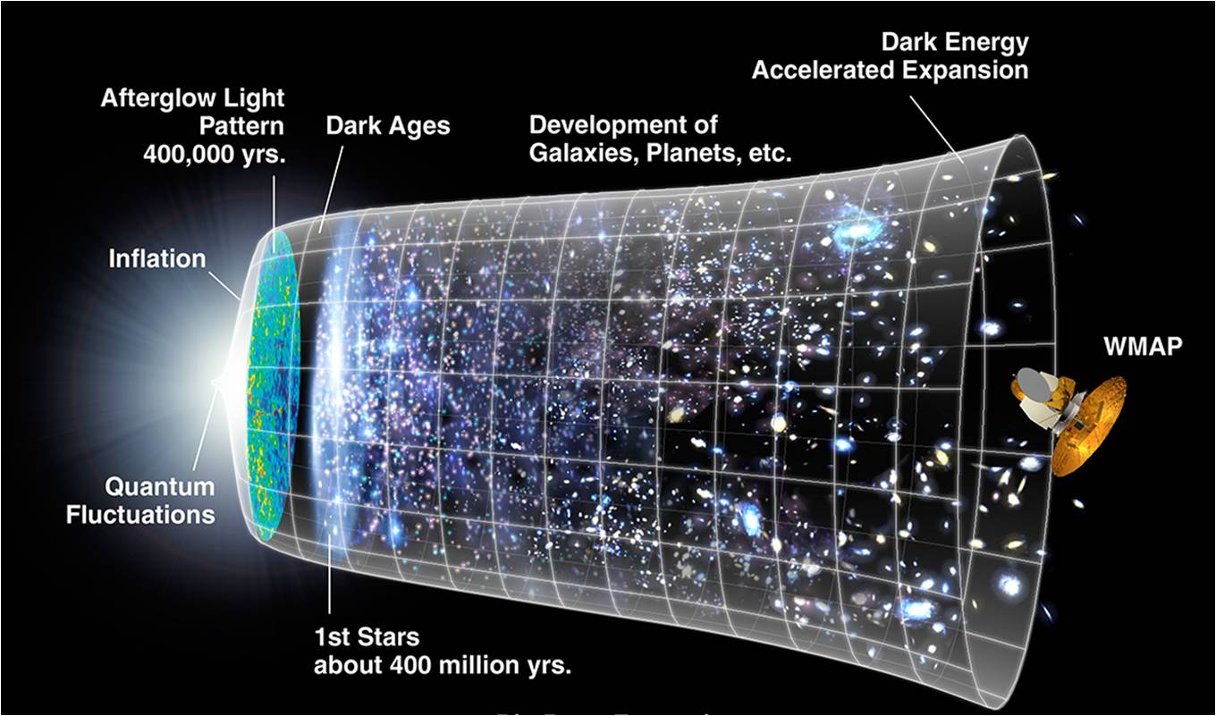
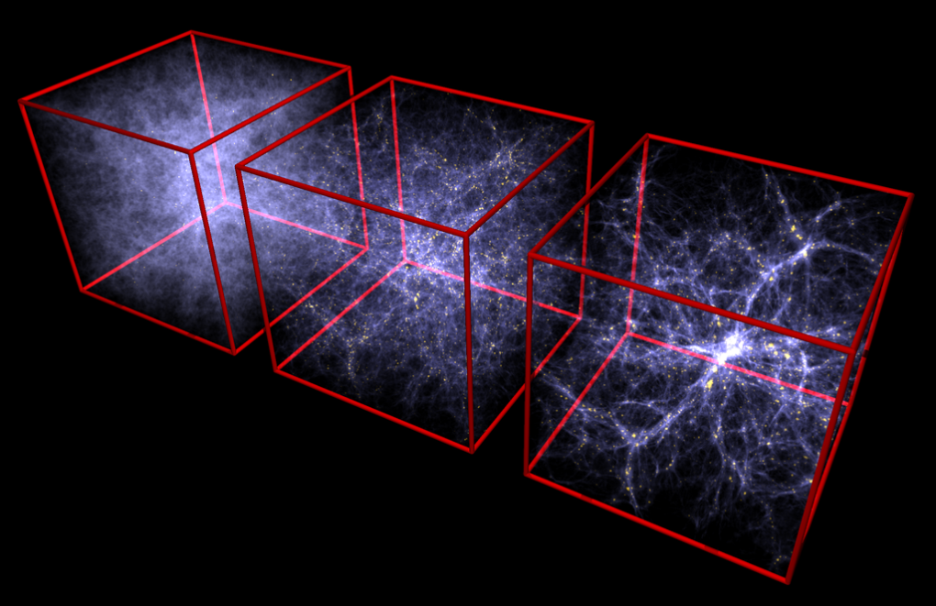
1. Introduction: HI Cosmology
1.1 Background
The spatial distribution of galaxies, referred to as the Large Scale Structure in the Universe, is fundamental to understand the formation and evolution of galaxies and cosmic structures.

Slide 3
1. Introduction: HI Cosmology
1.1 Background
The spatial distribution of galaxies, referred to as the Large Scale Structure in the Universe, is fundamental to understand the formation and evolution of galaxies and cosmic structures.
However, when we observe distant galaxies, the sample galaxies are inevitably biased to luminous ones.
Very “primitive” galaxies which have a large amount of gas and have not formed stars yet tend to be dropped from the sample

Slide 4
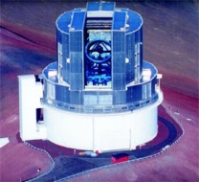
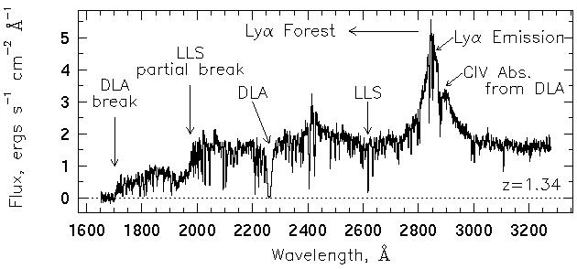
1.1 Background
A method to detect this kind of very young galaxies is a survey of Lyman α absorption line systems in the optical spectra of background luminous objects like quasars.
Quasar
Observer

Slide 5
1.1 Background
A method to detect this kind of very young galaxies is a survey of Lyman α absorption line systems in the optical spectra of background luminous objects like quasars.
Quasar
Observer
Especially, systems with a high hydrogen column density are referred to as damped Lyman α systems (DLAs) which are believed to be ancestors of giant galaxies today.

Slide 6
1.1 Background
Quasar
Observer
These systems are found to be indeed gas-rich and metal-poor systems (e.g., Ledoux et al. 2003).
Also they are a unique tool to explore the power spectrum of cosmological density fluctuation at small scales.
They are, for example, used for the precision cosmology, like examination of the cosmological primordial power spectrum or neutrino mass (e.g., Ichiki et al. 2009).

Slide 7
1.2 Problem
Quasar
Observer
However, there is a fundamental problem in the optical/UV-based method.

Slide 8
1.2 Problem
Quasar
Observer
However, there is a fundamental problem in the optical/UV-based method.
Though we search absorption line systems, if there is a very high column density system exists in front of a background quasar, the quasar itself is dropped from the original selection because of strong extinction (Vladilo & Péroux 2005).

Slide 9
1.2 Problem
Quasar
Observer
Since such a high column-density systems are very probably the objects which will start burst of star formation soon, they are exactly the objects we are looking for, and substantially important for the evaluation of the cosmic star formation.

Slide 10
1.2 Problem
Quasar
Observer
Since such a high column-density systems are very probably the objects which will start burst of star formation soon, they are exactly the objects we are looking for, and substantially important for the evaluation of the cosmic star formation.
This bias is FATAL for the aim of our study!

Slide 11
1.3 Solution
Quasar
Observer
How can we avoid this fatal bias?

Slide 12
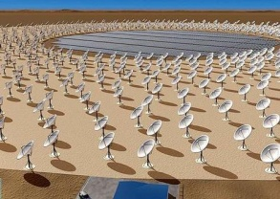
1.3 Solution
Quasar
Observer
How can we avoid this fatal bias?
We can select a quasar sample by radio continuum emission, and survey the absorption systems by 21cm lines.
Advantages comparing to the optical/UV absorption surveys are
The extinction from dust is almost negligible at radio wavelengths.
Because of small cross section, we can observe very high column density systems.

Slide 13
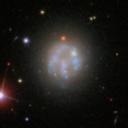
1.3 Solution
Quasar
Observer
In addition to the radio absorption observations, we also do some ancillary observations, like radio emission line surveys or optical spectroscopy/imaging.

Slide 14
1.4 Modeling
Quasar
Observer
In addition to the radio absorption observations, we also do some ancillary observations, like radio emission line surveys or optical spectroscopy/imaging.
However, to predict how they look and to interpret obtained data, we must construct theoretical models which can trace the formation and evolution of galaxies through the cosmic age, including the Dark Ages.

Slide 15
2. Methodology and Strategy
2.1 Primeval galaxies in cosmological simulations
Large scale distribution of gas can be treated by the cosmological perturbation theory.
For absorptions, not only a large-scale gas distribution but also gravitationally condensed objects of gas and dark matter, i.e., primeval galaxies in minihalos contribute significantly.
To estimate the abundance and spatial distribution of primeval galaxies, cosmological simulations are needed:
N-body + SPH.

Slide 16
2.1 Primeval galaxies in cosmological simulations
We need to develop a new simulation, especially in order to treat the structure in the early Universe at small scales. It is important to include the effect of star formation, but still many problems remain unsolved.
Base: GADGET (Springel, Yoshida, & White 2001)
Specific aspects for the early Universe:
Misalignment/shift between the motion of dark matter and baryons (e.g., Naoz et al. 2011).
Subsonic motion of baryons (e.g., Tseliakhovich & Hirata 2010).
Currently working members: Ichiki, Shimabukuro, Sekiguchi (Nagoya), Yoshikawa, Hasegawa (Tsukuba), Yokoyama (Tokyo)

Slide 17
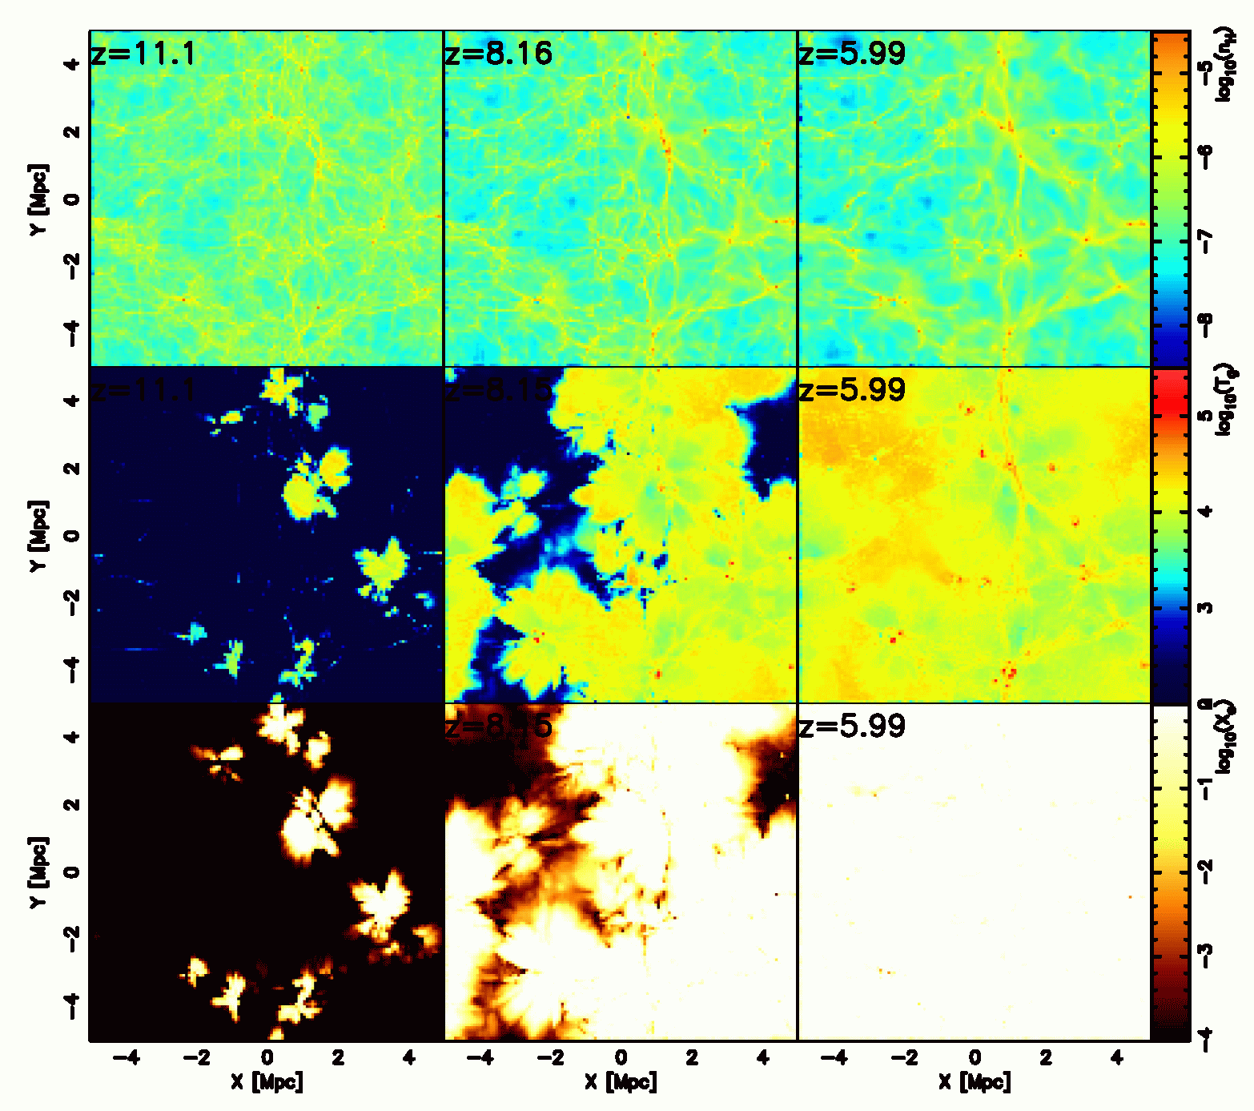
2.1 Primeval galaxies in cosmological simulations
Cosmic reionization simulation by Tsukuba team
Cosmological N-body+SPH simulation coupled with radiative transfer.
By solving the photoionization of H and He, and photodissociation of H₂ together with gas dynamics, this can calculate the self-regulating star formation and reionization in halos.
Hasegawa & Semelin, in preparation

Slide 18
2.2 State and evolution of gas in primeval galaxies
In galaxy scale, we want to predict the strength of emission and absorption lines as well as line width theoretically.
Ingredients:
Conversion from gas to stars: Schmidt law is adopted.
Absorption line of neutral hydrogen:
Phase of the ISM should be taken into account.
Spin temperature also matters: a code treating heating and cooling is already available (Hirashita & Ferrara 2002)
Currently working members: Hirashita (ASIAA), Takeuchi, Asano, Suzuki (Nagoya)

Slide 19
2.3 Physics of Background Continuum Sources
We also need to develop a model of the background light continuum sources like quasars and early gamma-ray bursts (GRBs).
Particularly important is to predict the radio spectra of the background objects, their luminosity function, frequency of occurrence, and observational feasibility.
Assuming that the fraction of radio loud quasars are constant with time, we can adopt the Local bulge-black hole mass relation to high-z Universe.
At z > 10, quasar density is expected to decrease significantly, and GRBs are good candidate radio sources

Slide 20
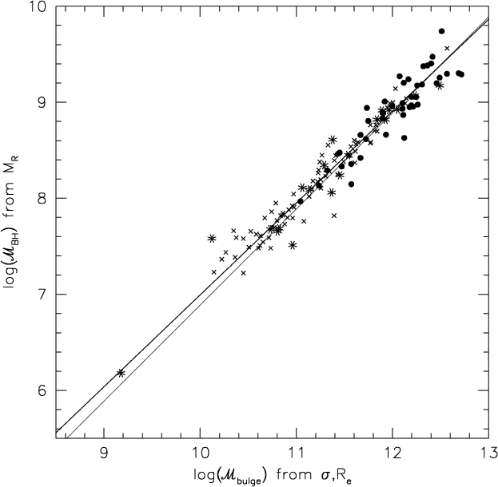
2.3 Physics of Background Continuum Sources
Quasars
Radio loud quasars are only a small fraction among all. Observationally it is well known that they are associated with strong jets, and having elliptical galaxies as their host (in the low-z Universe).
It is suggested that the merger history of their hosts and/or angular momentum of gas around the central BHs are relevant to their properties.
We model quasars with some empirical relations, as well as their environments.
Black hole mass [M☉]
Bulge mass [M☉]
Bettoni et al. (2003)

Slide 21
2.3 Physics of Background Continuum Sources
Gamma-ray bursts
We can estimate the density of surrounding ISM by connecting the radio spectrum and the light curve of the GRBs. It may be also possible to detect the molecular absorption lines like CO on their spectra.
Through these observations, we can expect information of the physics of first stars (Inoue et al. 2007).
Currently working members: Inoue (Tokyo), Takahashi (Kumamoto), Ichiki (Nagoya)

Slide 22
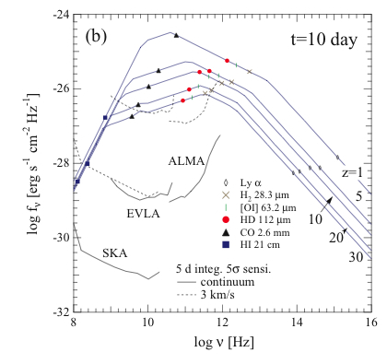
2.3 Physics of Background Continuum Sources
Gamma-ray burst afterglow spectrum
Inoue, Omukai, & Ciardi (2007)

Slide 23
3. Further Related Topics
3.1 Examination of gas distribution
Though the exploration of the reionization epoch is not possible now, because the data are not available yet, we can explore the hydrogen gas distribution in the Local Universe through the data by Chang et al. (2010).
As for the 21cm absorption, we think we can measure the small scale fluctuation in the reionization, as well as its epoch. Through local observations, we explore the performance of 21cm absorption line surveys.

Slide 24
3.1 Examination of gas distribution
The 21cm absorption line observation of high-z objects is also the central interest of preceding projects.
ASKAP (Australia)
MeerCAT (South Africa)
We collaborate with these projects to establish a methodology how to extract the information of galaxy evolution and reionization. Takahashi (Kumamoto) is keeping a contact with these teams.
Currently working members: Ichiki, Kashino (Nagoya), Inoue (Tokyo), Takahashi (Kumamoto)

Slide 25
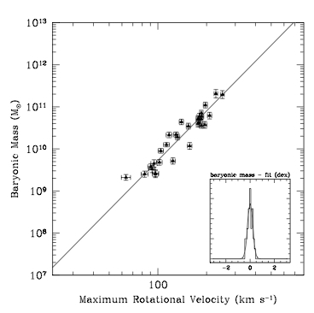
3.2 Baryonic Tully-Fisher Relation (BTF)
The BTF was discovered by McGaugh (2000), and regarded as an important empirical relation connecting the halo (dynamical) mass and baryon content. Especially important for very late type galaxies (HI-dominated in baryonic content).
This requires not only absorption but also emission observations of 21cm lines.
But this is an important challenge to understand the physics which relates dark halos and baryon contents (stars and gas), especially for the lowest mass galaxies.
Meyer et al. (2008)
Baryon mass [M☉]
Rotation velocity [kms⁻¹]

Slide 26
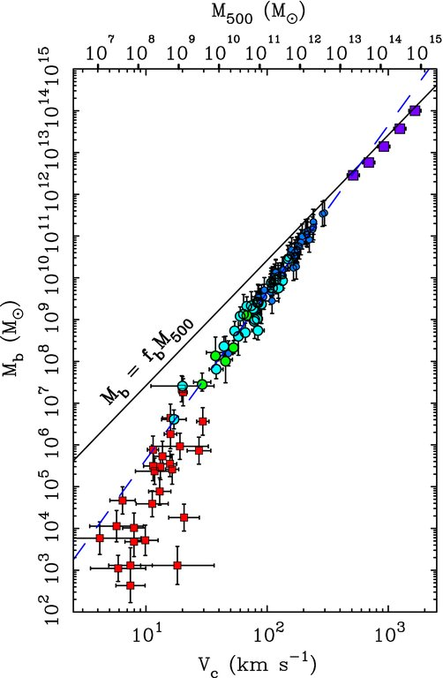
3.2 Baryonic Tully-Fisher Relation (BTF)
The “extended” BTF (McGaugh et al. 2010)
The slope becomes steeper from the largest to the smallest structures (clusters: violet symbols, giant galaxies: blue symbols, and dwarf spheroidals: red symbols).
⇒ Possible effect of feedback?
However, smallest gaseous dwarfs are missing on this plot. We need to explore the lower HI mass.
Currently working members: Takeuchi, Yuan, Ishikawa, Suzuki (Nagoya)

Slide 27
3.3 Primordial non-Gaussianity through HI
The power spectrum of the primordial fluctuation
The interest of cosmologists today is the property of the primordial fluctuation in the Universe. We can study this issue observationally by HI.
Current observations predict that the primordial fluctuation has almost Gaussian statistics as expected from the linear perturbation theory.
Now the primordial non-Gaussianity is hitting the limelight of cosmologists (Komatsu & Spergel 2001, and many others).

Slide 28
Parameterization with f_{NL}
The non-Gaussianity is a very broad concept and no systematic way to investigate it was known until recently.
The situation has dramatically changed by the introduction of the nonlinearity parameter, f_{NL}. The primordial perturbation Φ is described as
Non-zero f_{NL} gives
Higher order contribution in the power spectrum (2-point correlation function.)
Leading order contribution in the bispectrum (3-point correlation function).

Slide 29
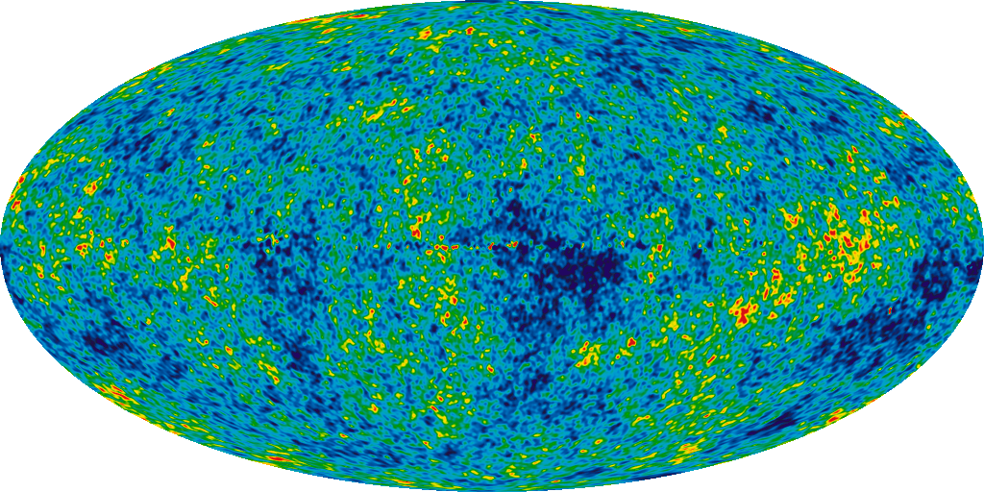
Bispectrum of the CMB temperature fluctuations
The bispectrum (Fourier transformed 3-point correlation) of the CMB brightness temperature map can be used to estimate f_{NL} efficiently (Cooray 2006).
Bandwidth: 1 MHz
Frequency: 14 - 45 MHz
(z ~ 100-30)
Multipole: ℓ_{max} ~ 10⁵
⇒
But we need estimation for lower redshifts.
3D data!!
CMB observations
Planck
2D data
Currently working members: Sekiguchi (Nagoya), Yokoyama (Tokyo)

Slide 30
4. Summary
Absorption line systems in optical/UV spectra of quasars are a useful tool for exploring gaseous systems, but if there is a very high column density system exists in front of a background quasar, the quasar itself is dropped from the original selection because of strong extinction.
To avoid this fatal bias, we can select a quasar sample by radio continuum emission, and survey the absorption systems by 21cm lines.
To estimate the abundance and spatial distribution of primeval galaxies, cosmological simulations with N-body + SPH and radiative transfer are needed. We need to develop a new simulation, to treat especially the structure in the early Universe at small scales. It is important to include the effect of star formation, but still many problems are remain unsolved.

Slide 31
4. Summary
In galaxy scale, we want to predict the strength of emission and absorption lines as well as line width theoretically.
We also need to develop a model of the background light continuum sources like quasars and early gamma-ray bursts (GRBs).
As for the 21cm absorption, we think we can measure the small scale fluctuation in the reionization, as well as its epoch.
The 21cm absorption line observation of high-z objects is also the central interest of preceding projects, like ASKAP and MeerCAT.

Slide 32
4. Summary
The BTF is an important relation to connect halo and baryon contents in galaxies. At smallest scales, the relation is uncertain, and HI observation will be a powerful tool to explore it.
The interest of cosmologists today is the property of the primordial fluctuation in the Universe. We can study this issue observationally by HI. Now the primordial non-Gaussianity is hitting the limelight of cosmologists. The bispectrum of the CMB brightness temperature map can be used to estimate f_{NL} efficiently

Slide 33
4. Summary
People who are interested in any of these topics are welcome.
Especially, we want observational astronomers!

